Slide 1
HOW WAS THE WORLD FORMED?
If you have ever looked at a landscape such as a mountain, a river valley or a beach and wondered how it was formed, this is the task for you:

Slide 2
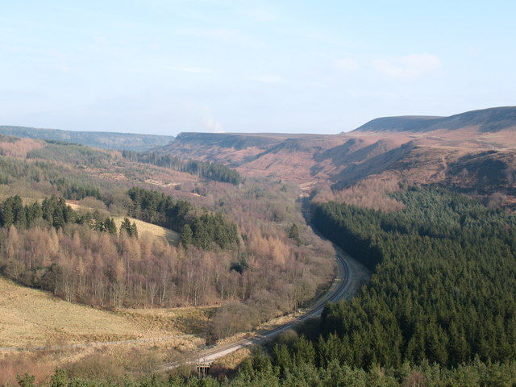
Newtondale: North York Moors

Slide 3
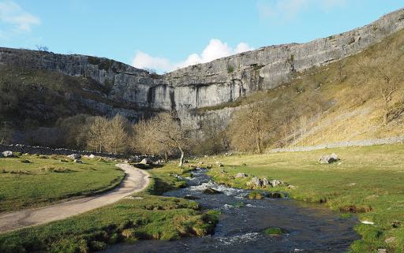
Malham Cove: Yorkshire Dales

Slide 4
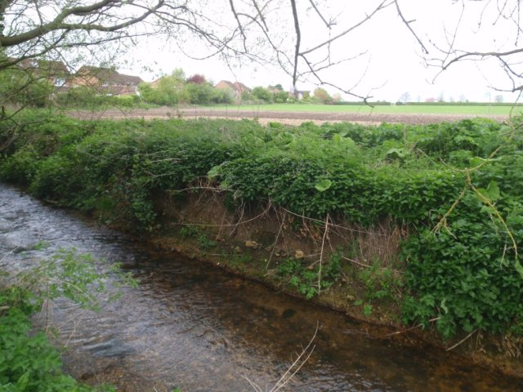
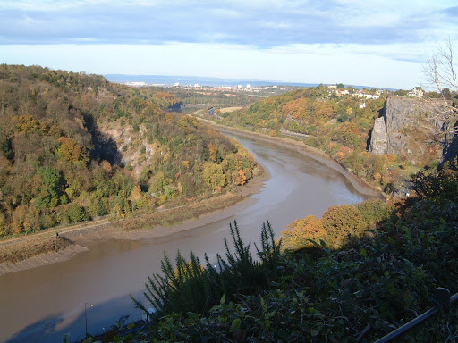
Uniformitarianism: “The key to the past can be seen in the present”.
Which means that if a process is happening today, then it probably also happened during the past.
For example, if a river is slowly eroding its valley today, then larger valleys will have been slowly eroded over a much longer time, during the past.

Slide 5
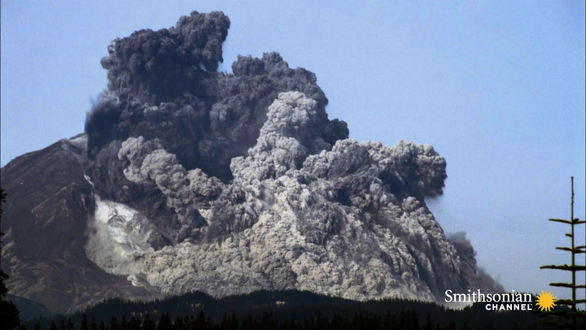
Catastrophism: “The earth’s surface has mostly been shaped by sudden, huge, violent and short-lived events, such as volcanic eruptions and meteorite strikes”.

Slide 6
Which of these ideas, “Uniformitarianism” or “Catastrophism” do you find more realistic and why? Good starting points for research would be to look for information about: i) “Hutton’s Unconformity” at Siccar Point and ii) The origin of the “Scablands” in Washington State, USA.

