Slide 1
Learning from home...extension opportunities!
January 2021

Slide 2
A range of learning ideas...
BBC Bitesize
Ted Education
Seneca Learning
Khan Academy
Activity Village
BBC Teach
Newsela
Pearson Learners
Twinkl
Quizlet
Barclay's Lifeskills

Slide 3
Online courses...
A range of short, online courses available from leading universities, organisations and employers… usually for free!
Futurelearn
01
Alison
02
Coursera
03
Edx
04

Slide 4
Take a tour, learn a language, explore history...
Trip Savvy – Virtual Museums visits
Trip Savvy – Best virtual vacations
Virtual Field trips
National Geographic
Pompeii Virtual Tour
Duolingo
British Museum
Fire of London
Ancient Rome – Virtual Tour

Slide 5
Explore literature, music and the arts...
East Riding Library
Audible
The Globe
Literacy Trust
Abdo
The Louvre
The Courtauld Institute
Tate Galleries
National Gallery
Music Lab
Artrageous
BBC Ten Pieces
Truetube

Slide 6
STEM activities to try..
NASA activities
STEM activities to try at home
BP educational service
Natural History Museum
Minecraft activities
Code Combat
Tynker
Pixar
Kano

Slide 7
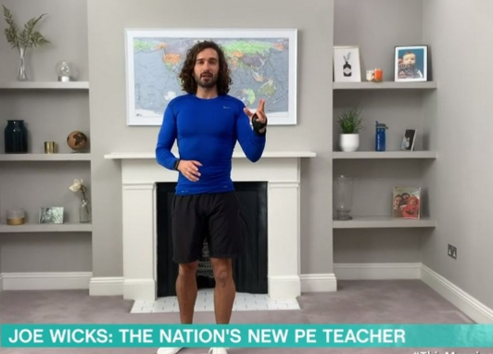
For something completely different...!

