Slide 1
U6th Business Transition Lessons
2020

Slide 2
Feedback on Sure Chill – 10 marker

Slide 3
12 Marker

Slide 4
Transition task – choose 10-20 companies that you would invest in now!
Task specifics:
Choose between 10 and 20 companies.
Look at where we are on the Economic Cycle
Using long term social trends
Using companies you can identify and explain what they do

Slide 5
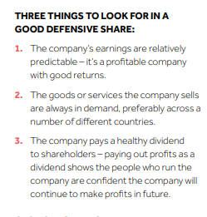
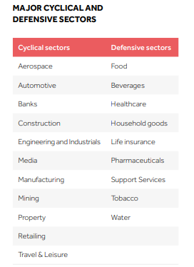
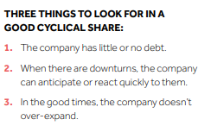

Slide 6
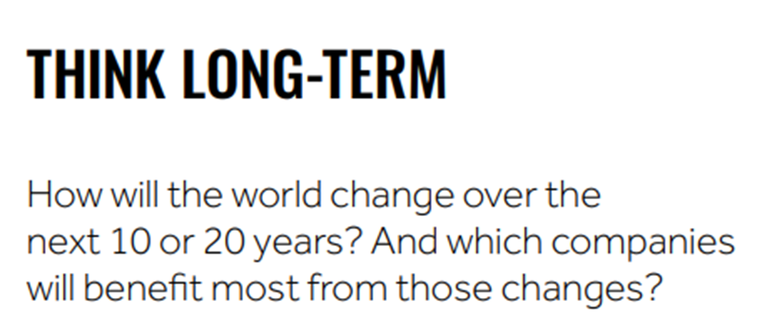

Slide 7
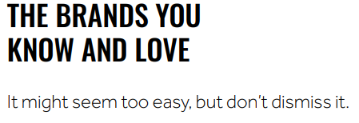

Slide 8
Which companies have you identified and why
Break out

Slide 10
Feedback and next lesson!

