Slide 3
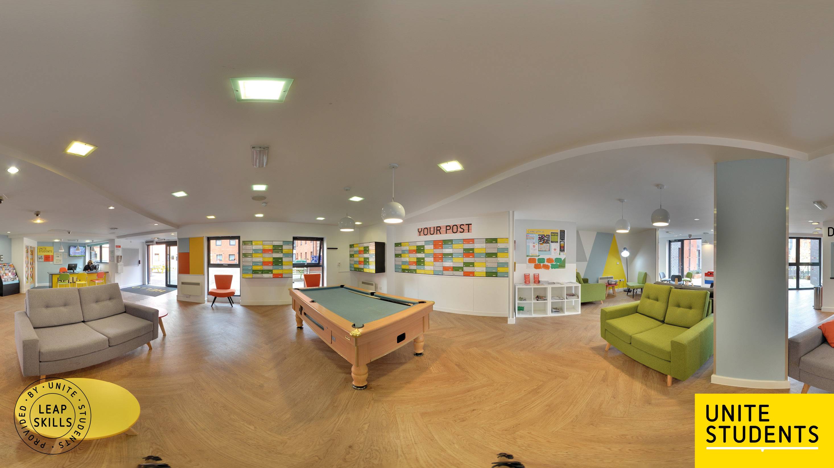
Notes:
- Link shorturl.at/elmvx

Slide 5
Notes:
Link to student game resource-https://leapskills.unitestudents.com/students

Slide 6
• Is there a chance of potential conflict if different personality types are sharing together? Can this be prevented? How?
• Which scenario/question did you find the most challenging? Why?
• What are some other ways of dealing with this situation?
• What might be the consequences of these decisions?

Slide 7
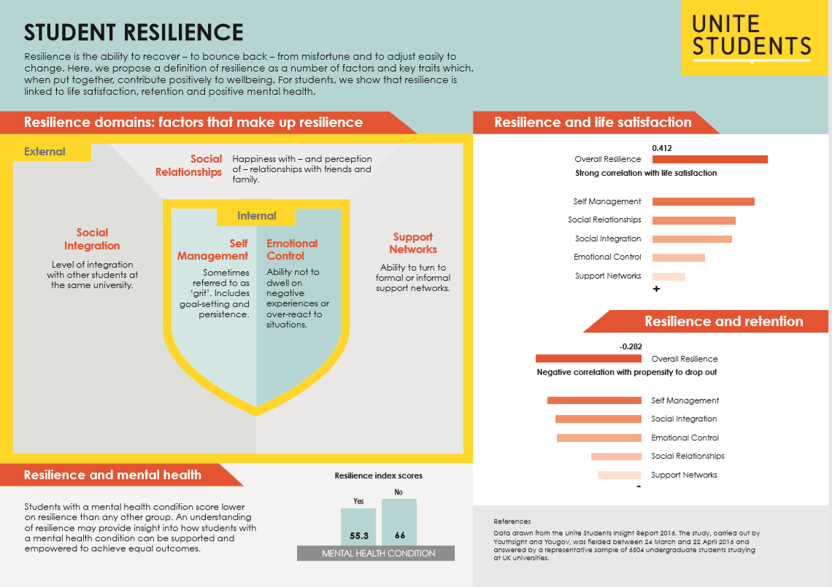

Slide 9
Notes:
Link: https://www.youtube.com/watch?time_continue=3&v=nuhXOEduzzo

Slide 10
