Slide 1
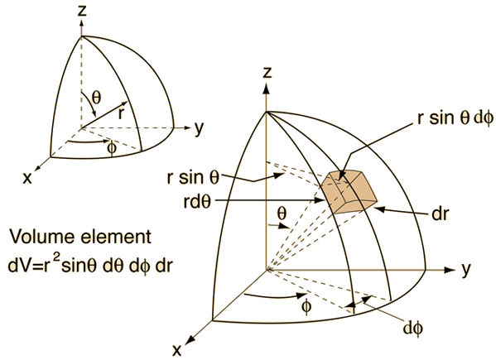
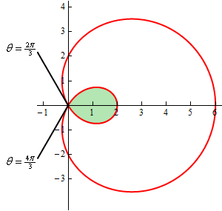
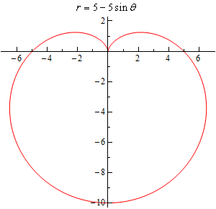
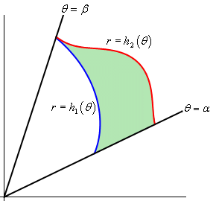
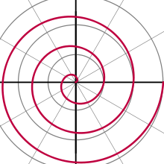
Polar Coordinates

Slide 2
Introduction
Polar coordinates are an alternative system to Cartesian coordinates
Some processes and equations involving the Cartesian system can become very complicated
You can simplify some of these by using Polar coordinates instead
Polar coordinates can also be used effectively to describe circular patterns, such as a moth flying towards a light, or the motion of planets, and spirals

Slide 3
Teachings for
Exercise 7A

Slide 4
Polar Coordinates
Cartesian coordinates – use horizontal and vertical position
You need to be able to use both Polar and Cartesian Coordinates
You will no doubt be very familiar with the Cartesian way of describing coordinates using x and y as the horizontal and vertical distances from the origin
Polar coordinates describe equivalent points, but in a different way
Polar coordinates use the distance from the origin, and the angle from the positive x-axis
(3,4)
4
4
3
1
(-4,-1)
Polar coordinates – use the distance and the angle
(5, 0.93)
5
0.93^{c}
3.39^{c}
You can use radians or degrees, but radians will be most commonly used in this chapter
→ You can also use negative equivalent values for the angles (being measured the opposite way)
4.2
(4.2, 3.39)
7A

Slide 5
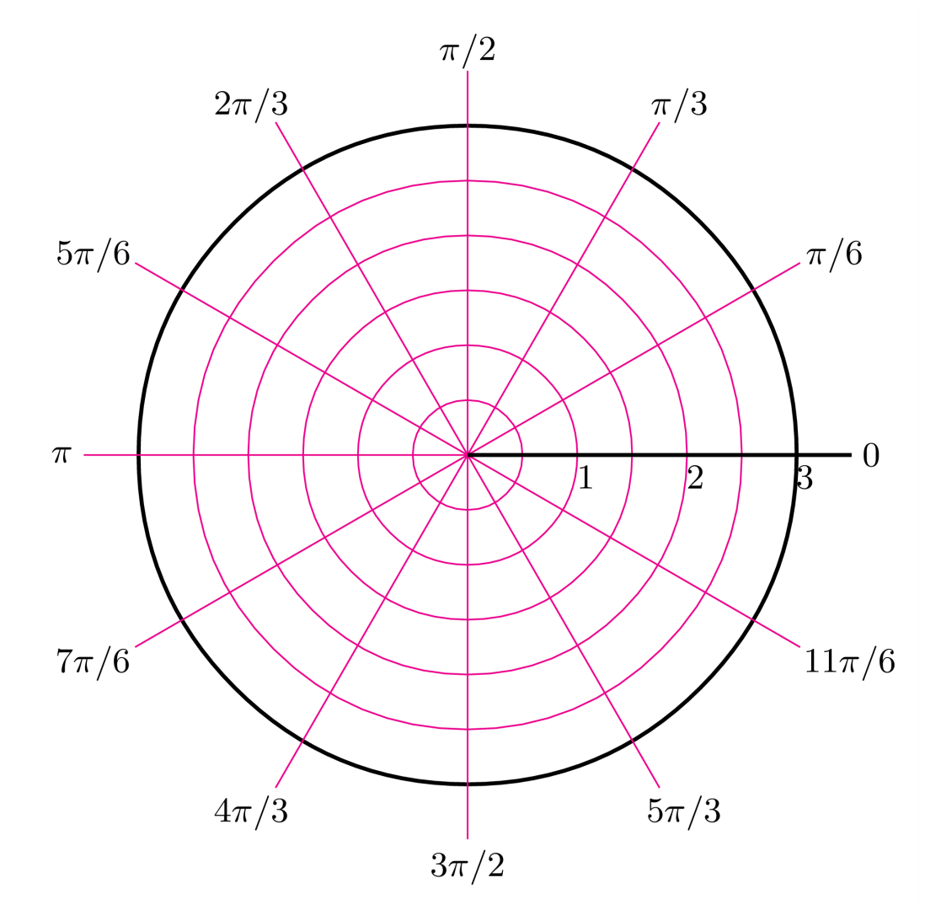
Polar Coordinates
You need to be able to use both Polar and Cartesian Coordinates
You will no doubt be very familiar with the Cartesian way of describing coordinates using x and y as the horizontal and vertical distances from the origin
Polar coordinates describe equivalent points, but in a different way
Polar coordinates use the distance from the origin, and the angle from the positive x-axis
You sometimes see Polar coordinates plotted on a Polar grid, but a Cartesian set of axes are fine as well!
7A

Slide 6
Polar Coordinates
$$y=rsinθ$$
$$x=rcosθ$$
$$r^{2}=x^{2}+y^{2}$$
$$θ=arctan\left(\frac{y}{x}\right)$$
You need to be able to use both Polar and Cartesian Coordinates
You need to know some simple formulae linking Cartesian and Polar coordinates
These come from using GCSE Trigonometry and Pythagoras…
(x,y)
Hyp
r
Opp
y
θ
x
Adj
$$Tanθ=\frac{Opp}{Adj}$$
$$Adj=cosθ×Hyp$$
Sub in Adj and Hyp
Sub in Opp and Adj
$$x=rcosθ$$
$$Tanθ=\frac{y}{x}$$
Tan⁻¹ (also known as arctan)
$$c^{2}=a^{2}+b^{2}$$
$$Opp=sinθ×Hyp$$
$$θ=arctan\left(\frac{y}{x}\right)$$
Sub in r, x and y
Sub in Opp and Hyp
$$r^{2}=x^{2}+y^{2}$$
$$y=rsinθ$$
7A

Slide 7
Polar Coordinates
$$y=rsinθ$$
$$x=rcosθ$$
$$r^{2}=x^{2}+y^{2}$$
$$θ=arctan\left(\frac{y}{x}\right)$$
(5,9)
Draw a diagram
You need to be able to use both Polar and Cartesian Coordinates
Find the Polar coordinates of the following point:
You need to find the values of r and θ
The Polar coordinate is then written as (r, θ)
r
9
θ
$$(5,9)$$
5
$$r^{2}=x^{2}+y^{2}$$
Sub in x and y
$$r^{2}=5^{2}+9^{2}$$
Calculate
$$r=10.3$$
Cartesian
Polar
$$θ=arctan\left(\frac{y}{x}\right)$$
$$(5,9)$$
$$(10.3, 60.9°)$$
Sub in x and y
$$θ=arctan\left(\frac{9}{5}\right)$$
Calculate in degrees or radians
$$θ=60.9°$$
7A

Slide 8
Polar Coordinates
$$y=rsinθ$$
$$x=rcosθ$$
$$r^{2}=x^{2}+y^{2}$$
$$θ=arctan\left(\frac{y}{x}\right)$$
Draw a diagram
You need to be able to use both Polar and Cartesian Coordinates
Find the Polar coordinates of the following point:
You need to find the values of r and θ
The Polar coordinate is then written as (r, θ)
5
$$(5,−12)$$
θ
$$r^{2}=x^{2}+y^{2}$$
12
Sub in x and y
r
$$r^{2}=5^{2}+12$$
Calculate
$$r=13$$
(5,-12)
Cartesian
Polar
$$θ=arctan\left(\frac{y}{x}\right)$$
$$(5,−12)$$
$$(13, −67.4°)$$
Sub in x and y
$$θ=arctan\left(\frac{12}{5}\right)$$
Notice the angle is negative, as we have measured it the opposite way (clockwise)
Calculate in degrees or radians
$$θ=67.4°$$
7A

Slide 9
Polar Coordinates
$$y=rsinθ$$
$$x=rcosθ$$
$$r^{2}=x^{2}+y^{2}$$
$$θ=arctan\left(\frac{y}{x}\right)$$
Draw a diagram
You need to be able to use both Polar and Cartesian Coordinates
Find the Polar coordinates of the following point:
You need to find the values of r and θ
The Polar coordinate is then written as (r, θ)
√3
$$(−\sqrt{3},−1)$$
1
θ
r
(√3,-1)
$$r^{2}=x^{2}+y^{2}$$
$$θ=arctan\left(\frac{y}{x}\right)$$
Cartesian
Polar
Sub in x and y
$$\left(2,\frac{7π}{6}\right)$$
Sub in x and y
$$(−\sqrt{3},−1)$$
$$r^{2}={(\sqrt{3})}^{2}+1^{2}$$
$$θ=arctan\left(\frac{1}{\sqrt{3}}\right)$$
Calculate
Calculate in degrees or radians
$$r=2$$
Notice we added π to the angle, so it would be in the correct quadrant (^{π}/₆ on its own when measured clockwise would not be in the right place!)
$$θ=\frac{π}{6}$$
7A

Slide 10
Polar Coordinates
$$y=rsinθ$$
$$x=rcosθ$$
$$r^{2}=x^{2}+y^{2}$$
$$θ=arctan\left(\frac{y}{x}\right)$$
^{π}/₂
Draw a diagram
You need to be able to use both Polar and Cartesian Coordinates
Convert the following Polar coordinate into Cartesian form.
As usual draw a diagram, and think carefully about which quadrant this point is in
A half turn would be π, and a ³/₄ turn would be ^{3π}/₂, so this will be between those
The angle in the triangle will be ^{π}/₃, as π has been ‘used’ in the half-turn…
$$\left(10, \frac{4π}{3}\right)$$
5
π
^{π}/₃
0
5√3
10
(10,^{4π}/₃)
^{3π}/₂
$$x=rcosθ$$
$$y=rsinθ$$
Sub in values
Sub in values
$$x=10cos\left(\frac{π}{3}\right)$$
$$y=10sin\left(\frac{π}{3}\right)$$
Calculate
Calculate
$$x=5$$
$$y=5\sqrt{3}$$
So the Cartesian coordinate is (-5,-5√3) (remember to interpret whether values should be negative or positive from the diagram!)
7A

Slide 11
Polar Coordinates
$$y=rsinθ$$
$$x=rcosθ$$
$$r^{2}=x^{2}+y^{2}$$
$$θ=arctan\left(\frac{y}{x}\right)$$
(8,^{2π}/₃)
^{π}/₂
Draw a diagram
You need to be able to use both Polar and Cartesian Coordinates
Convert the following Polar coordinate into Cartesian form.
As usual draw a diagram, and think carefully about which quadrant this point is in
The angle in the triangle will be ^{π}/₃, calculated by subtracting ^{2π}/₃ from π
8
4√3
$$\left(8, \frac{2π}{3}\right)$$
^{π}/₃
π
0
4
^{3π}/₂
$$x=rcosθ$$
$$y=rsinθ$$
Sub in values
Sub in values
$$x=8cos\left(\frac{π}{3}\right)$$
$$y=8sin\left(\frac{π}{3}\right)$$
Calculate
Calculate
$$x=4$$
$$y=4\sqrt{3}$$
So the Cartesian coordinate is (-4,4√3) (remember to interpret whether values should be negative or positive from the diagram!)

Slide 12
Teachings for
Exercise 7B

Slide 13
Polar Coordinates
$$θ=arctan\left(\frac{y}{x}\right)$$
$$r^{2}=x^{2}+y^{2}$$
$$y=rsinθ$$
$$x=rcosθ$$
You can switch between Polar and Cartesian equations of curves
You can convert between Cartesian equations of lines and Polar equations by using the relationships from the previous section (above)
Remember that a Cartesian equation of a line is telling you the relationship between the x and y values for the points on the line
A polar equation of a line is telling you the relationship between the distance from the origin, and the angle from the origin, of all the points on the line
7B

Slide 14
Polar Coordinates
$$θ=arctan\left(\frac{y}{x}\right)$$
$$r^{2}=x^{2}+y^{2}$$
$$y=rsinθ$$
$$x=rcosθ$$
You can switch between Polar and Cartesian equations of curves
Find a Cartesian equation of the following curve:
This process relies on creating some of the expressions above, in the equation you’re given
For example, if you can manipulate the equation to have ‘rsinθ’ in it, this can then be replaced with ‘y’
$$r=5$$
Square both sides
$$r^{2}=25$$
You can replace r² with an expression in x and y, from above
$$x^{2}+y^{2}=25$$
$$r=5$$
From your knowledge of equations, you should recognise this as a circle, centre (0,0) and radius 5
→ This makes sense as the Polar equation just states that the distance from the origin is 5, and doesn’t mention the angle
7B

Slide 15
Polar Coordinates
$$θ=arctan\left(\frac{y}{x}\right)$$
$$r^{2}=x^{2}+y^{2}$$
$$y=rsinθ$$
$$x=rcosθ$$
You can switch between Polar and Cartesian equations of curves
Find a Cartesian equation of the following curve:
Try to create one or more of the expressions above in the equation…
$$r=6cosecθ$$
Cosecθ = ¹/_{sinθ}
$$r=\frac{6}{sinθ}$$
Multiply by sinθ
$$r=6cosecθ$$
$$rsinθ=6$$
Replace rsinθ using an equation above
$$y=6$$
7B

Slide 16
Polar Coordinates
$$θ=arctan\left(\frac{y}{x}\right)$$
$$r^{2}=x^{2}+y^{2}$$
$$y=rsinθ$$
$$x=rcosθ$$
$$Cos2θ≡{2Cos}^{2}θ−1$$
You can switch between Polar and Cartesian equations of curves
Find a Cartesian equation of the following curve:
You will sometimes need to use the double angle formulae from C3, since our equations above only contain θ, rather than multiplies of it
$$Sin\left(A±B\right)≡SinACosB±CosASinB$$
$$Cos\left(A±B\right)≡CosACosB∓SinASinB$$
$$r=2+cos2θ$$
You get given these in the formula booklet, and they lead to the following:
$$Sin2θ≡2SinθCosθ$$
$${Cos}^{2}θ−{Sin}^{2}θ$$
Remember there are 3 possibilities for Cos2θ!
$$Cos2θ≡$$
$${2Cos}^{2}θ−1$$
$${1−2Sin}^{2}θ$$
You can use these to replace the 2θ in the expression with an expression using θ instead…
7B

Slide 17
Polar Coordinates
$$θ=arctan\left(\frac{y}{x}\right)$$
$$r^{2}=x^{2}+y^{2}$$
$$y=rsinθ$$
$$x=rcosθ$$
$$Cos2θ≡{2Cos}^{2}θ−1$$
You can switch between Polar and Cartesian equations of curves
Find a Cartesian equation of the following curve:
Replace the cos 2θ with an equivalent expression in θ
Find a way to replace r³
$$r=2+cos2θ$$
Replace cos2θ using the equation above
$$r=2+({2Cos}^{2}θ−1)$$
Simplify
$$r=1+{2Cos}^{2}θ$$
$$r=2+cos2θ$$
Multiply by r² (this will allow us to replace the trigonometric part)
$$r^{3}=r^{2}+{2r^{2}Cos}^{2}θ$$
Replace the r and cos terms with equivalents in x and y
$${\left(x^{2}+y^{2}\right)}^{\frac{3}{2}}=$$
$$x^{2}+y^{2}+$$
$$2x^{2}$$
Simplify
$${\left(x^{2}+y^{2}\right)}^{\frac{3}{2}}={3x}^{2}+y^{2}$$
$$r^{2}=x^{2}+y^{2}$$
$$r={\left(x^{2}+y^{2}\right)}^{\frac{1}{2}}$$
Square root
One of the key advantages of Polar equations is that they can explain very complicated Cartesian equations in a much simpler way!
Multiply both to find an expression for r³
$$r^{3}={\left(x^{2}+y^{2}\right)}^{\frac{3}{2}}$$
7B

Slide 18
Polar Coordinates
$$θ=arctan\left(\frac{y}{x}\right)$$
$$r^{2}=x^{2}+y^{2}$$
$$y=rsinθ$$
$$x=rcosθ$$
$$Sin2θ≡2sinθcosθ$$
You can switch between Polar and Cartesian equations of curves
Find a Cartesian equation of the following curve:
Sometimes you cannot just replace everything straight away!
Replacing r² immediately would still leave us with the trigonometric part…
$$r^{2}=Sin2θ$$
Replace sin2θ using a double angle formula
$$r^{2}=2sinθcosθ$$
Multiply by r²
$$r^{4}=2r^{2}sinθcosθ$$
Imagine rewriting each side (makes it easier to see the simplification)
$$r^{2}=Sin2θ$$
$${\left(r^{2}\right)}^{2}=2rsinθrcosθ$$
Replace the r and trig terms with equivalents in x and y
$${\left(x^{2}+y^{2}\right)}^{2}=$$
$$2xy$$
7B

Slide 19
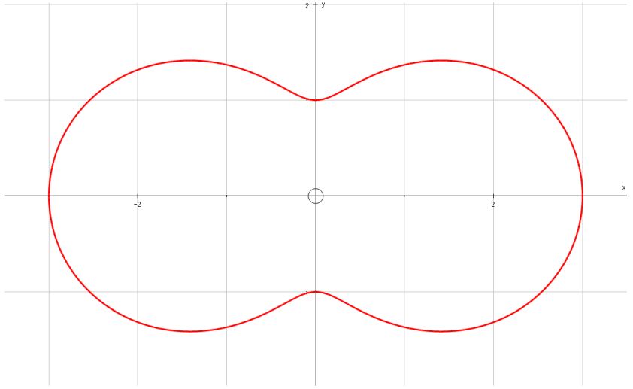
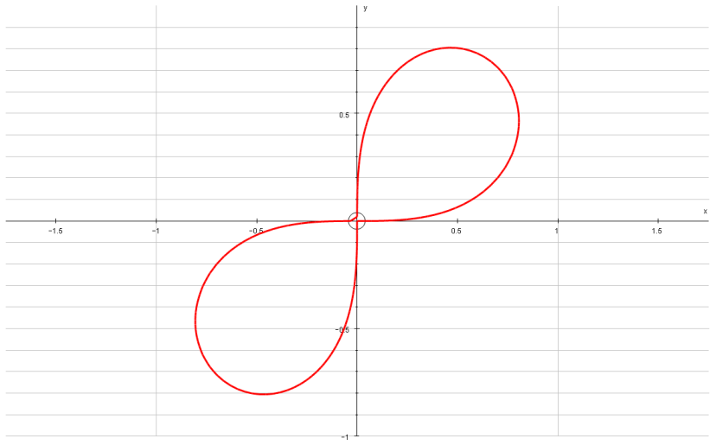
Polar Coordinates
$$θ=arctan\left(\frac{y}{x}\right)$$
$$r^{2}=x^{2}+y^{2}$$
$$y=rsinθ$$
$$x=rcosθ$$
$$Sin2θ≡2sinθcosθ$$
You can switch between Polar and Cartesian equations of curves
$${\left(x^{2}+y^{2}\right)}^{\frac{3}{2}}={3x}^{2}+y^{2}$$
$${\left(x^{2}+y^{2}\right)}^{2}=$$
$$2xy$$
7B

Slide 20
Polar Coordinates
$$θ=arctan\left(\frac{y}{x}\right)$$
$$r^{2}=x^{2}+y^{2}$$
$$y=rsinθ$$
$$x=rcosθ$$
You can switch between Polar and Cartesian equations of curves
Find a Polar equivalent for the following Cartesian equation:
Polar equations are usually written as ‘r = ‘ or ‘r² = ‘, so use the equations above to try and achieve this
$$y^{2}=4x$$
Replace y and x with equivalents
$$r^{2}\sin^{2}θ=4rcosθ$$
Divide by r
$$r\sin^{2}θ=4cosθ$$
$$y^{2}=4x$$
$$r=\frac{4cosθ}{\sin^{2}θ}$$
Divide by sin²θ
Imagine the fraction was split up
$$r=\frac{4cosθ}{sinθ}×\frac{1}{sinθ}$$
Both parts can be re-written
$$r=4cotθcosecθ$$
7B

Slide 21
Polar Coordinates
$$θ=arctan\left(\frac{y}{x}\right)$$
$$r^{2}=x^{2}+y^{2}$$
$$y=rsinθ$$
$$x=rcosθ$$
$$Cos2θ≡{Cos}^{2}θ−{Sin}^{2}θ$$
You can switch between Polar and Cartesian equations of curves
Find a Polar equivalent for the following Cartesian equation:
Polar equations are usually written as ‘r = ‘ or ‘r² = ‘, so use the equations above to try and achieve this
$$x^{2}−y^{2}=5$$
Replace x and y from above
$$r^{2}\cos^{2}θ−r^{2}\sin^{2}θ=5$$
Factorise
$$r^{2}\left(\cos^{2}θ−\sin^{2}θ\right)=5$$
The expression in brackets is one we saw earlier for cos2θ
$$x^{2}−y^{2}=5$$
$$r^{2}cos2θ=5$$
$$r^{2}=\frac{5}{cos2θ}$$
Divide by cos2θ
Rewrite
$$r^{2}=5sec2θ$$
7B

Slide 22
Polar Coordinates
$$θ=arctan\left(\frac{y}{x}\right)$$
$$r^{2}=x^{2}+y^{2}$$
$$y=rsinθ$$
$$x=rcosθ$$
You can switch between Polar and Cartesian equations of curves
Find a Polar equivalent for the following Cartesian equation:
Polar equations are usually written as ‘r = ‘ or ‘r² = ‘, so use the equations above to try and achieve this
This next step is tricky to spot, but it is possible to write the bracket using sine only
This again relies on the formulae from C3…
$$y\sqrt{3}=x+4$$
Replace x and y from above
$$r\sqrt{3}sinθ=rcosθ+4$$
Subtract rcosθ
$$r\sqrt{3}sinθ−rcosθ=4$$
Factorise the left side
$$y\sqrt{3}=x+4$$
$$r\left(\sqrt{3}sinθ−cosθ\right)=4$$
Divide both sides by 2 (do this inside the bracket rather than outside – the reason will become apparent in a moment…)
$$r\left(\frac{\sqrt{3}}{2}sinθ−\frac{1}{2}cosθ\right)=2$$
Replace the bracket with the expression we found
$$rsin\left(θ−\frac{π}{6}\right)=2$$
$$Sin\left(A−B\right)≡SinACosB−CosASinB$$
Let A = θ and B = ^{π}/₆
$$Sin\left(θ−\frac{π}{6}\right)≡SinθCos\frac{π}{6}−CosθSin\frac{π}{6}$$
$$Sin\left(θ−\frac{π}{6}\right)≡\frac{\sqrt{3}}{2}Sinθ−\frac{1}{2}Cosθ$$
Calculate the parts with ^{π}/₆
This is equivalent to the part in the brackets, so we can replace it!
7B

Slide 23
Polar Coordinates
$$θ=arctan\left(\frac{y}{x}\right)$$
$$r^{2}=x^{2}+y^{2}$$
$$y=rsinθ$$
$$x=rcosθ$$
You can switch between Polar and Cartesian equations of curves
Find a Polar equivalent for the following Cartesian equation:
Polar equations are usually written as ‘r = ‘ or ‘r² = ‘, so use the equations above to try and achieve this
This next step is tricky to spot, but it is possible to write the bracket using sine only
This again relies on the formulae from C3…
$$y\sqrt{3}=x+4$$
Replace x and y from above
$$r\sqrt{3}sinθ=rcosθ+4$$
Subtract rcosθ
$$r\sqrt{3}sinθ−rcosθ=4$$
Factorise the left side
$$y\sqrt{3}=x+4$$
$$r\left(\sqrt{3}sinθ−cosθ\right)=4$$
Divide both sides by 2 (do this inside the bracket rather than outside – the reason will become apparent in a moment…)
$$r\left(\frac{\sqrt{3}}{2}sinθ−\frac{1}{2}cosθ\right)=2$$
Replace the bracket with the expression we found
$$rsin\left(θ−\frac{π}{6}\right)=2$$
Divide by the expression in sine
$$r=\frac{2}{sin\left(θ−\frac{π}{6}\right)}$$
Rewrite
$$r=2cosec\left(θ−\frac{π}{6}\right)$$
7B

Slide 24
Polar Coordinates
$$θ=arctan\left(\frac{y}{x}\right)$$
$$r^{2}=x^{2}+y^{2}$$
$$y=rsinθ$$
$$x=rcosθ$$
You can switch between Polar and Cartesian equations of curves
$$r\left(\frac{\sqrt{3}}{2}sinθ−\frac{1}{2}cosθ\right)=2$$
An expression like this can be simplified in the way we just did
Both the numerical parts need to be able to be rewritten as sin and cos of the same angle (in the previous example, ^{π}/₆ gave us the answers we needed)
You can manipulate the expression to give values that work
If it is possible you need to consider whether it is an expansion of sin or cos, and also whether it is an addition or a subtraction…
7B

Slide 25
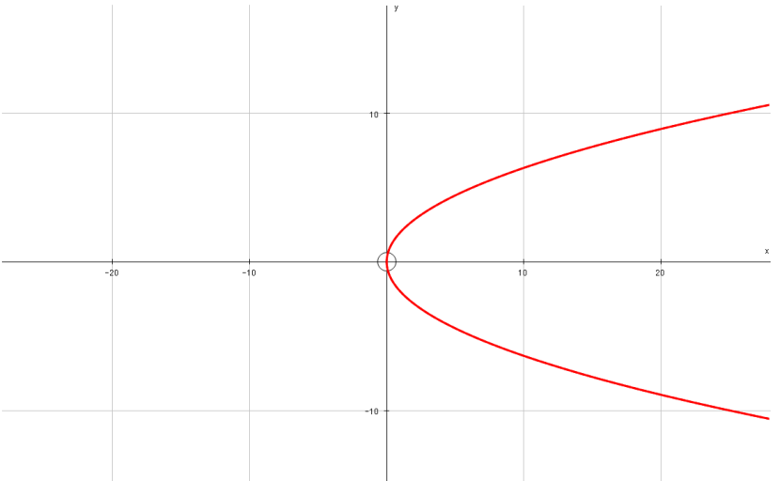
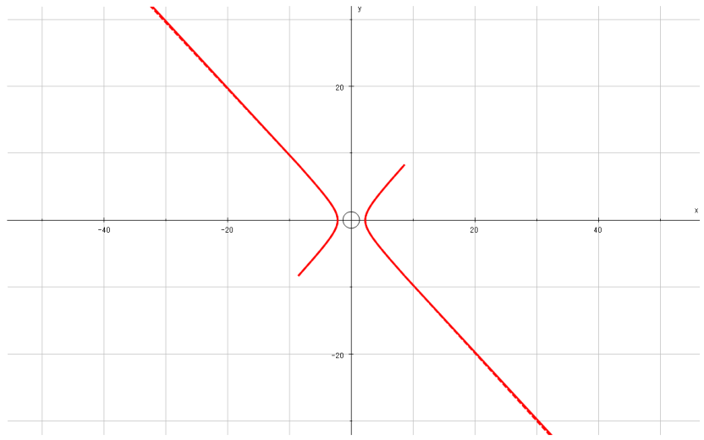
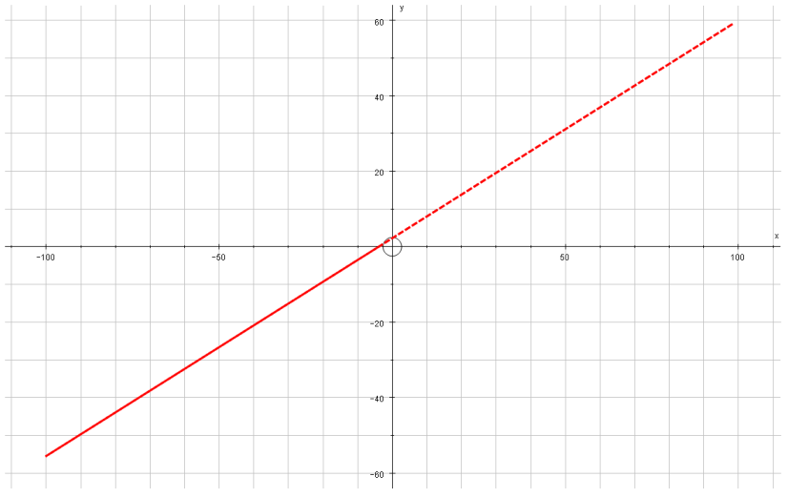
Polar Coordinates
$$θ=arctan\left(\frac{y}{x}\right)$$
$$r^{2}=x^{2}+y^{2}$$
$$y=rsinθ$$
$$x=rcosθ$$
You can switch between Polar and Cartesian equations of curves
$$r=4cotθcosecθ$$
$$r^{2}=5sec2θ$$
$$r=2cosec\left(θ−\frac{π}{6}\right)$$
7B

Slide 26
Teachings for
Exercise 7C

Slide 27
Polar Coordinates
You can sketch curves based on their Polar equations
In FP2 we do not plot any points for a polar curve that give a negative value of r.
If you think about it, if you get a negative value for r, the logical way to deal with it would be to plot it in the opposite direction
However, changing the direction would mean that the angle used to calculate the value is now different, so the pair of values cannot go together
Hence, for FP2, we ignore situations where r < 0
7C

Slide 28
Polar Coordinates
You can sketch curves based on their Polar equations
In FP2 we do not plot any points for a polar curve that give a negative value of r.
You will need to learn some basic shapes (at the end of this section I will show you a lot of examples!)
You will also need to think about how to go about plotting these graphs
Lets start with some basic shapes…
7C

Slide 29
Polar Coordinates
You can sketch curves based on their Polar equations
The Polar equation:
Is a circle, centre O and radius a.
→ The expression above is just saying that the distance from the origin is ‘a’, regardless of the angle
a
$$r=a$$
a
a
a
7C

Slide 30
Polar Coordinates
You can sketch curves based on their Polar equations
The Polar equation:
Is a half-line starting at O, making an angle of θ with the original.
We saw ‘half-lines’ in Chapter 3
Only half of the straight line will have the correct angle, which is why we cannot extend it to a full line
Sometime the other half of the line is drawn on (as a dotted part)
a
$$θ=a$$
7C

Slide 31
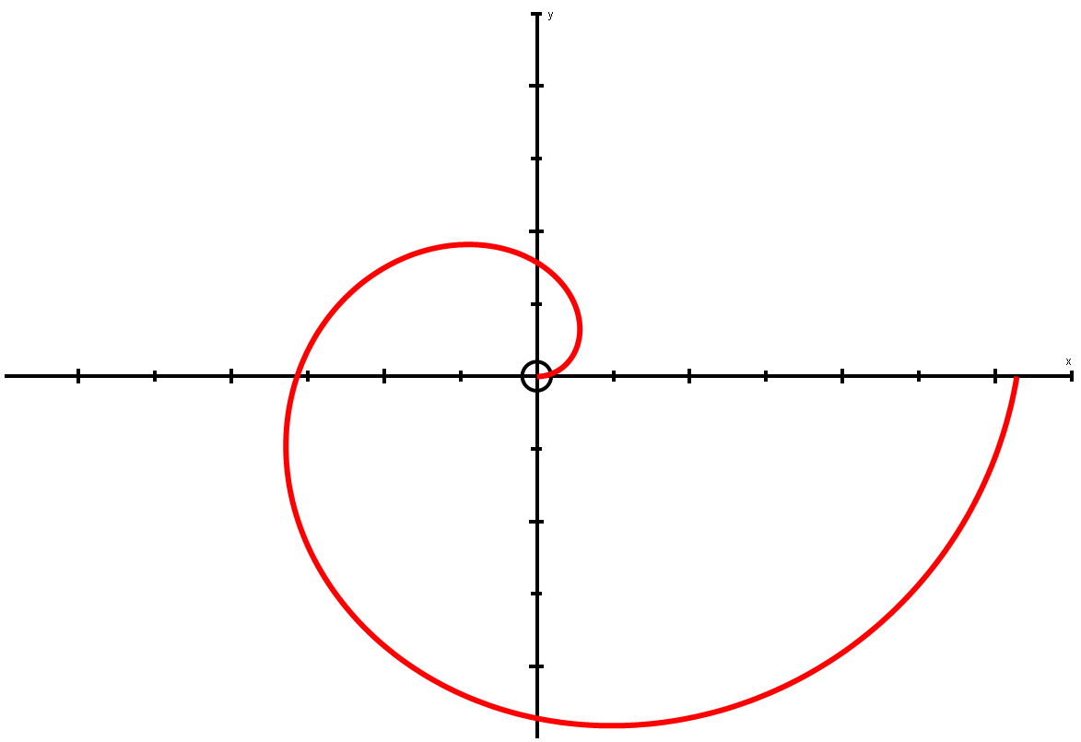
Polar Coordinates
It sometimes helps to label the axes with the angles they represent…
π 2
You can sketch curves based on their Polar equations
The Polar equation:
Is a spiral starting at O
This is where Polar lines start to get a bit more complicated!
Imagine working out some points – choose values of θ that are on the axes
$$r=aθ$$
^{aπ}/₂
aπ
2aπ
π
0
0, 2π
Bigger angle = bigger distance!
^{3aπ}/₂
3π 2
θ
0
^{π}/₂
π
^{3π}/₂
2π
$$r=aθ$$
r
0
^{aπ}/₂
aπ
^{3aπ}/₂
2aπ
Think about the equation – as the angle we turn through increases, so should the distance from the origin, O!
7C

Slide 32
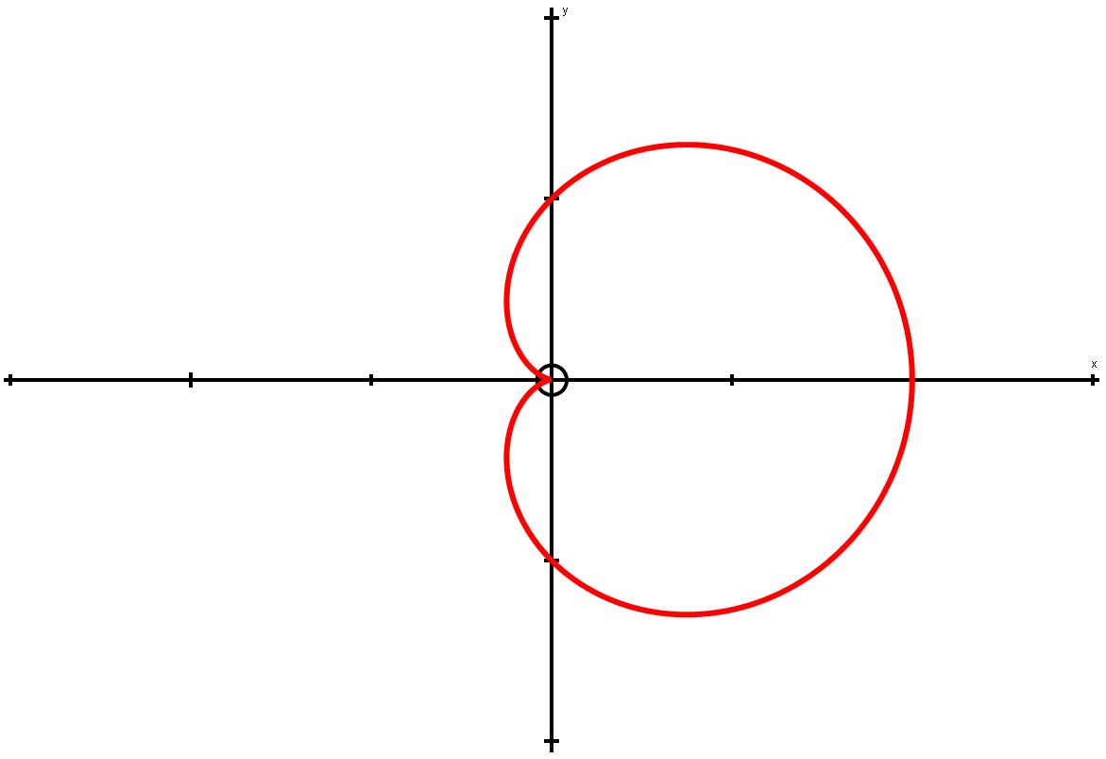
Polar Coordinates
π 2
You can sketch curves based on their Polar equations
Sketch the following curve:
Like last time, you can draw up a table of values
Think about what the value of cosθ will be for each of these…
This shape is called a Cardioid!
a
$$r=a(1+cosθ)$$
π
0
2a
0, 2π
a
θ
0
^{π}/₂
π
^{3π}/₂
2π
r
2a
a
0
a
2a
3π 2
1
Cosθ
0
θ = ^{3π}/₂, Cosθ = 0
θ = 0, Cosθ = 1
θ = 2π, Cosθ = 1
θ = ^{π}/₂, Cosθ = 0
θ = π, Cosθ = -1
-1
^{π}/₂
π
^{3π}/₂
2π
7C

Slide 33
Polar Coordinates
You can sketch curves based on their Polar equations
Sketch the following curve:
Sometimes, you can change the equation to a simple Cartesian one, in order to sketch it
Remember that this will not always make the equation easier to ‘understand’
$$r=asecθ$$
$$r=\frac{a}{cosθ}$$
Secθ = ¹/_{cosθ}
Multiply by cosθ
$$rcosθ=a$$
$$r=asecθ$$
rcosθ = x
$$x=a$$
a
7C

Slide 34
Polar Coordinates
You can sketch curves based on their Polar equations
Sketch the following curve:
In terms of working out points to plot, the angle (θ) only needs to go up to 2π as this is a complete turn
We could of course go further but we do not need to for now
As the angle in our equation is above is 3θ, we can go up to 6π
Let’s work out some values, up to 6π (use the same increments as before, ie) going up by ^{π}/₂ each time)
3θ
0
π 2
π
3π 2
2π
5π 2
3π
7π 2
4π
9π 2
5π
11π 2
6π
θ
0
π 6
π 3
π 2
2π 3
5π 6
π
7π 6
4π 3
3π 2
5π 3
11π 6
2π
r
0
1
0
-1
0
1
0
-1
0
1
0
-1
0
$$r=sin3θ$$
Remember that if we are going to plot points, we need values of θ (rather than 3θ)
Then substitute these into the equation to the left to find the distances for the given angles
We get this ‘up and down’ repeating pattern due to the shape of the sine graph…
1
Sinθ
0
-1
^{π}/₂
π
^{3π}/₂
2π
7C

Slide 35
Polar Coordinates
You can sketch curves based on their Polar equations
Sketch the following curve:
Now we can plot these. Remember we do not plot negative values…
You can think of the plotting as being in several ‘sections’
3θ
0
π 2
π
3π 2
2π
5π 2
3π
7π 2
4π
9π 2
5π
11π 2
6π
θ
0
π 6
π 3
π 2
2π 3
5π 6
π
7π 6
4π 3
3π 2
5π 3
11π 6
2π
r
0
1
0
-1
0
1
0
-1
0
1
0
-1
0
$$r=sin3θ$$
Hopefully you can see the ranges we need to plot are only the positive ones!
From ^{π}/₃ radians, we keep increasing the angle. The distance reaches -1 and then is back to 0 at ^{2π}/₃ radians
→ All the distances in this range are negative, so we do not plot them
We start at 0. By ^{π}/₆ radians, we are a distance 1 unit away from the origin.
As we keep increasing the angle, we then get closer, back to 0 radians at ^{π}/₃
From ^{2π}/₃ radians, we keep increasing the angle. The distance reaches 1 and then is back to 0 at π radians
→ These are positive so will be plotted!
7C

Slide 36
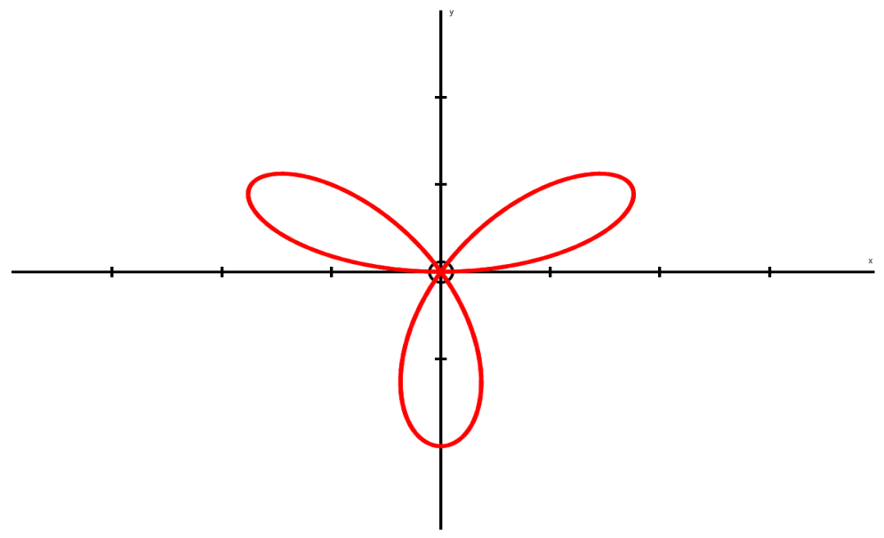
Polar Coordinates
You can sketch curves based on their Polar equations
Sketch the following curve:
Now we can plot these. Remember we do not plot negative values…
You can think of the plotting as being in several ‘sections’
3θ
0
π 2
π
3π 2
2π
5π 2
3π
7π 2
4π
9π 2
5π
11π 2
6π
θ
0
π 6
π 3
π 2
2π 3
5π 6
π
7π 6
4π 3
3π 2
5π 3
11π 6
2π
r
0
1
0
-1
0
1
0
-1
0
1
0
-1
0
$$r=sin3θ$$
π 2
As the angle increases, the distance does, up until ^{π}/₆ radians, when it starts to decrease again
(1,^{5π}/₆)
(1,^{π}/₆)
π
0
0, 2π
This pattern is repeated 3 times as we move though a complete turn!
(1,^{3π}/₂)
3π 2
7C

Slide 37
Polar Coordinates
You can sketch curves based on their Polar equations
Sketch the following curve:
Let’s do the same as for the last equation
As θ can go up to 2π, 2θ can go up to 4π, so we need to start by drawing up a table up to this value
2θ
0
π 2
π
3π 2
2π
5π 2
3π
7π 2
4π
θ
0
π 4
π 2
3π 4
π
5π 4
3π 2
7π 4
2π
r
a
0
-
0
a
0
-
0
a
$$r^{2}=a^{2}cos2θ$$
These values cannot be calculated here as we would have to square root a negative
→ They therefore will not be plotted…
7C

Slide 38
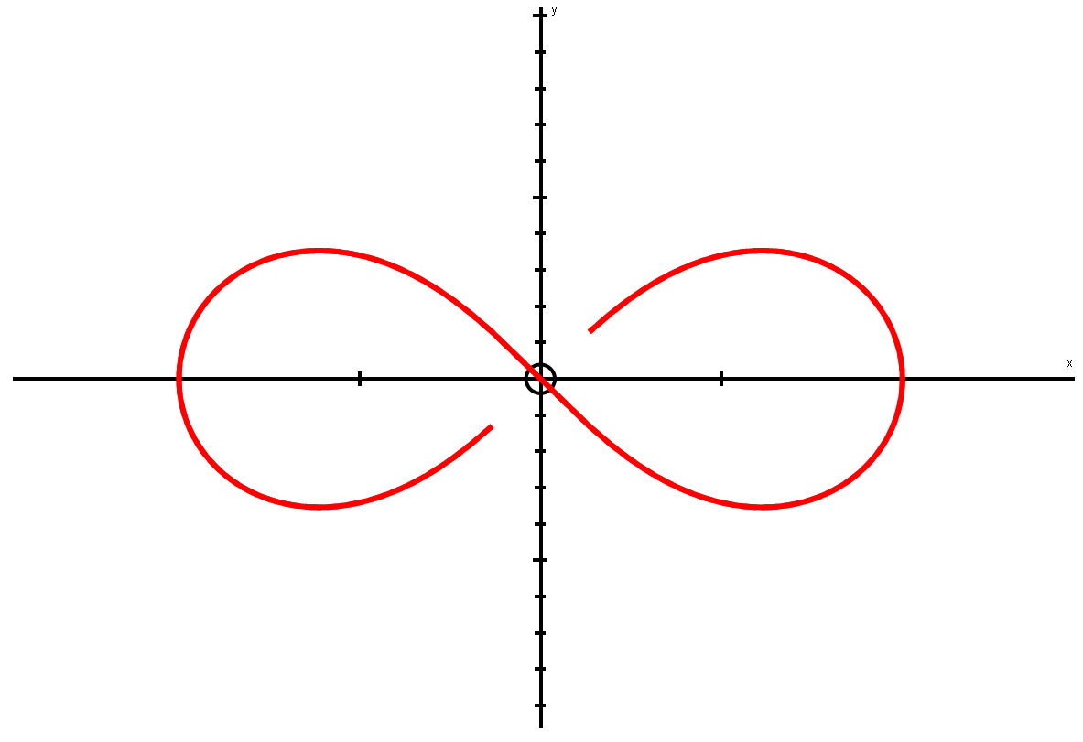
Polar Coordinates
You can sketch curves based on their Polar equations
Sketch the following curve:
Let’s do the same as for the last equation
As θ can go up to 2π, 2θ can go up to 4π, so we need to start by drawing up a table up to this value
2θ
0
π 2
π
3π 2
2π
5π 2
3π
7π 2
4π
θ
0
π 4
π 2
3π 4
π
5π 4
3π 2
7π 4
2π
r
a
0
-
0
a
0
-
0
a
$$r^{2}=a^{2}cos2θ$$
Curve starts at ‘a’
→ As we increase the angle, the distance moves to 0 by ^{π}/₄ radians
π 2
The curve then moves out again after ^{7π}/₄ radians until it is at a distance ‘a’ once more, after a complete turn (2π)
From ^{3π}/₄ radians, the curve increases out a distance of ‘a’, after π radians, then comes back
a
a
π
0, 2π
0
3π 2
7C

Slide 39
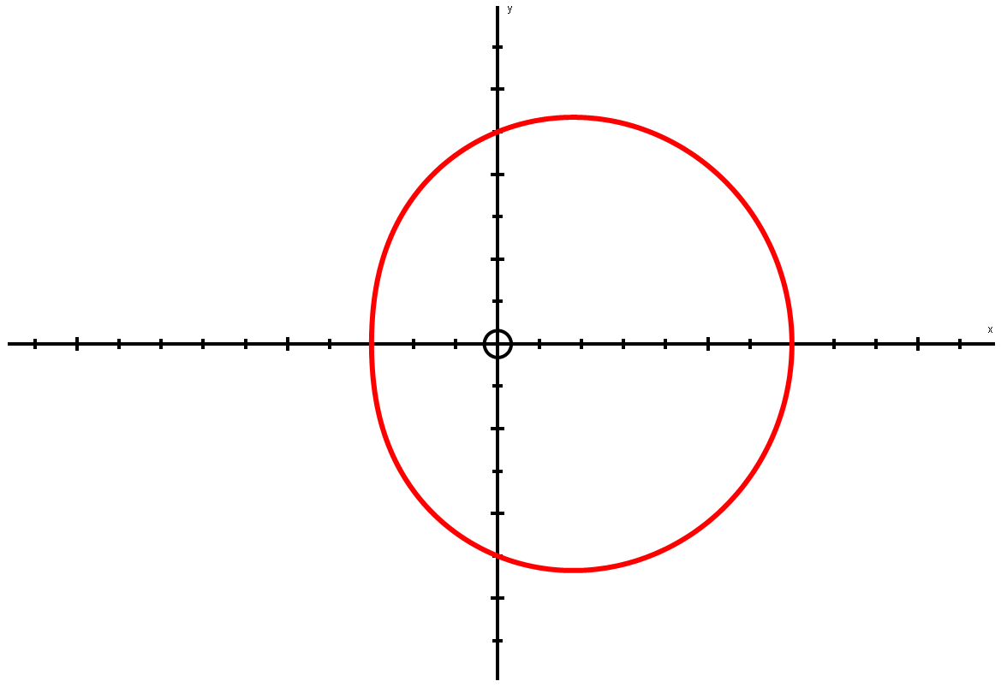
Polar Coordinates
You can sketch curves based on their Polar equations
Sketch the following curve:
→ Work out values up to 2π
π 2
$$r=a(5+2cosθ)$$
5a
θ
0
^{π}/₂
π
^{3π}/₂
2π
π
3a
7a
0, 2π
r
7a
5a
3a
5a
7a
r decreasing
r increasing
5a
As we increase the angle from 0 to π, the distance of the line from the origin becomes smaller
After π, we keep increasing the angle, but now the distance increases again at the same rate it was decreasing before…
3π 2
It is important to note that this it NOT a circle, it is more of an ‘egg’ shape!
7C

Slide 40
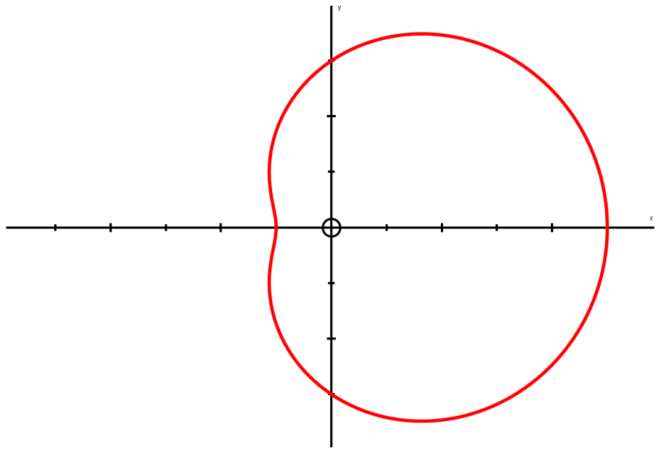
Polar Coordinates
You can sketch curves based on their Polar equations
Sketch the following curve:
Work out values up to 2π
This follows a similar pattern to the previous graph, but the actual shape is slightly different…
π 2
3a
$$r=a(3+2cosθ)$$
a
5a
π
θ
0
^{π}/₂
π
^{3π}/₂
2π
0, 2π
r
5a
3a
a
3a
5a
3a
3π 2
This shape has a ‘dimple’ in it
→ We will see the condition for this on the next slide…
7C

Slide 41
Polar Coordinates
You can sketch curves based on their Polar equations
Look at the patterns for graphs of the form:
$$r=a(p+qcosθ)$$
p < q
q ≤ p < 2q
As we would get some negative values for the distance, r (caused by cos being negative), so the graph is not defined for all values of θ
We will not plot this graph as some values cannot be calculated
If p is greater than q, but less than 2q, we get an egg-shape, but with a ‘dimple’ in it
(we will prove this in section 7E)
p = q
p ≥ 2q
When p = q, we will get a value of 0 for the distance at one point (when θ = π, as cos will be -1. Therefore we do p – q which cancel out as they’re equal)
→ This gives us the ‘cardioid’ shape
If p is equal to or greater than 2q, we get the ‘egg’ shape, but as a smooth curve, without a dimple
→ The greater p is, the ‘wider’ the egg gets stretched!
Note that ‘r = a(p + qsinθ)’ has the same pattern, but rotated 90 degrees anticlockwise!
7C

Slide 42
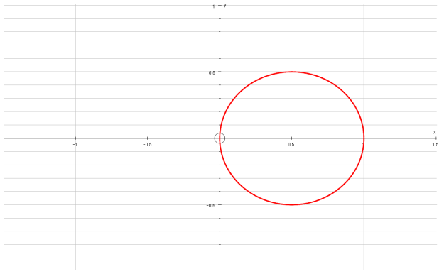
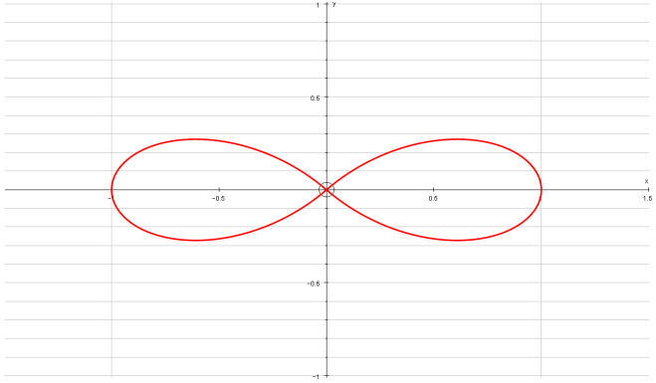
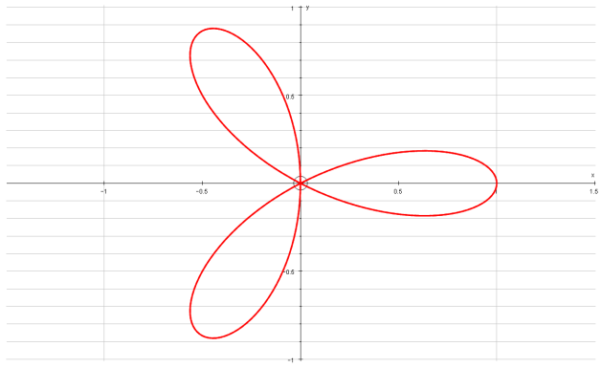
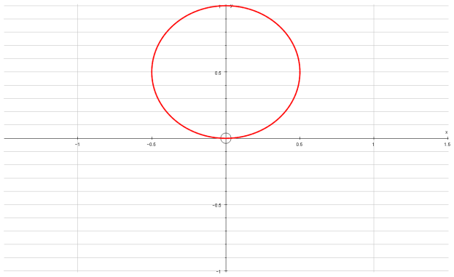
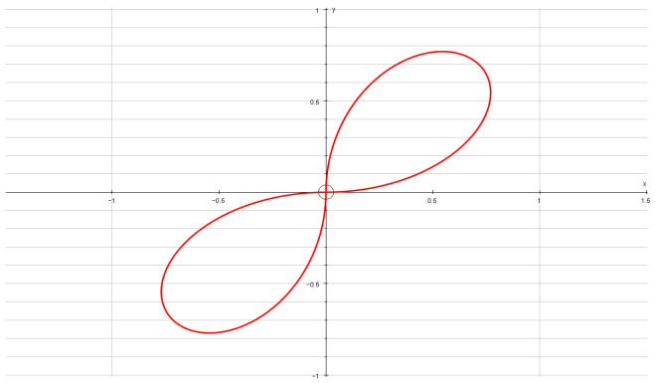
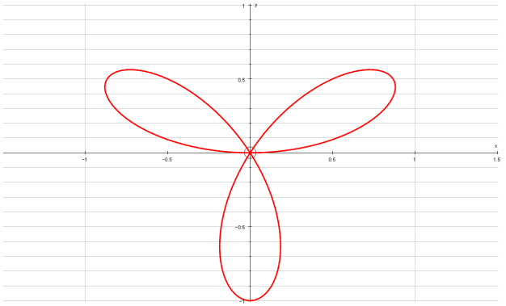
Polar Coordinates
You can sketch curves based on their Polar equations
You don’t need to memorise these shapes (as you can work them out if needed), but they are useful to be aware of (in addition to those you have seen so far…)
$$r=cosθ$$
$$r=cos2θ$$
$$r=cos3θ$$
$$r=sinθ$$
$$r=sin2θ$$
$$r=sin3θ$$
7C

Slide 43
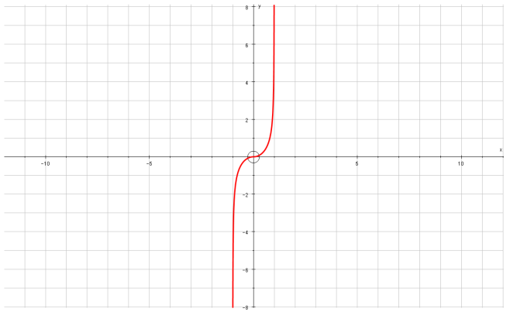
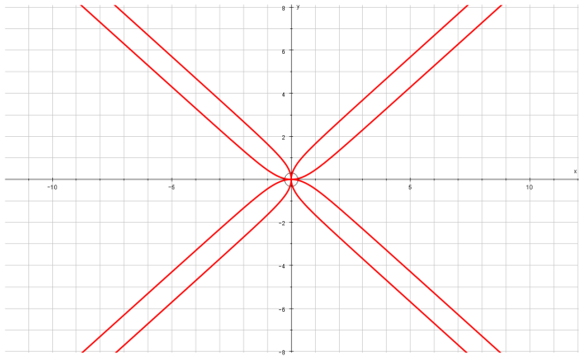
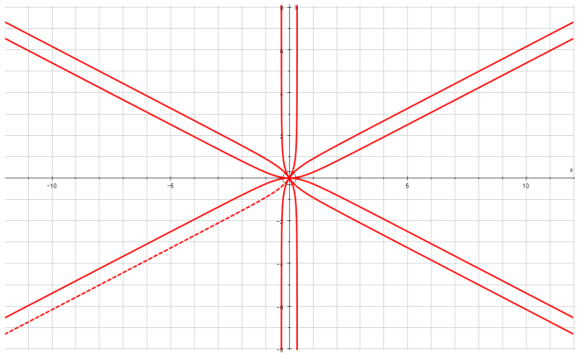
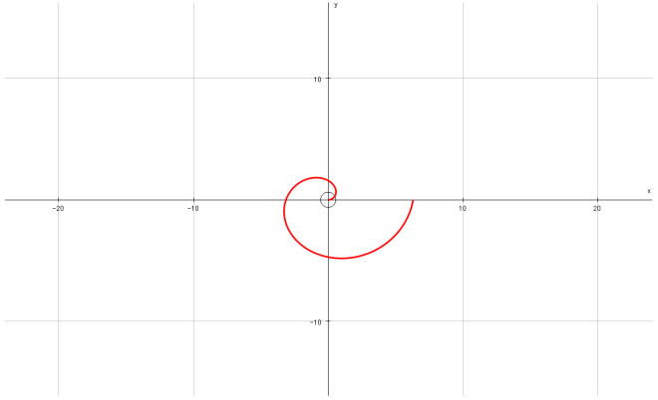
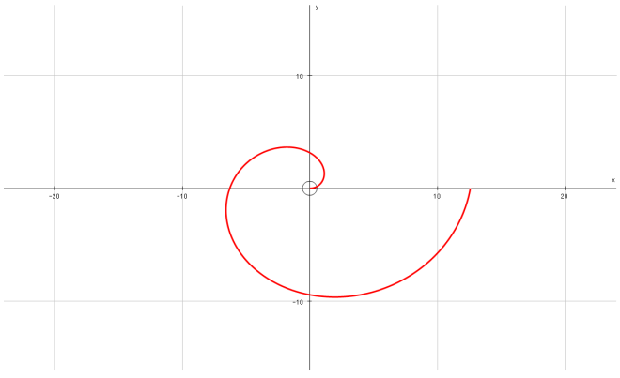
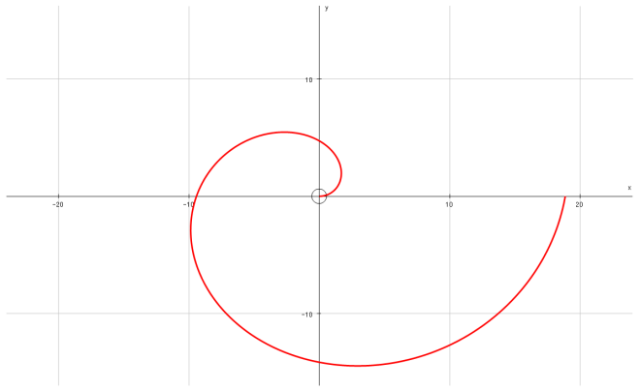
Polar Coordinates
You can sketch curves based on their Polar equations
You don’t need to memorise these shapes (as you can work them out if needed), but they are useful to be aware of (in addition to those you have seen so far…)
$$r=tanθ$$
$$r=tan2θ$$
$$r=tan3θ$$
$$r=θ$$
$$r=2θ$$
$$r=3θ$$
7C

Slide 44
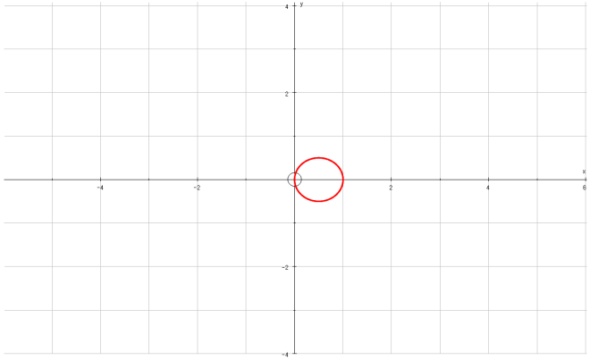
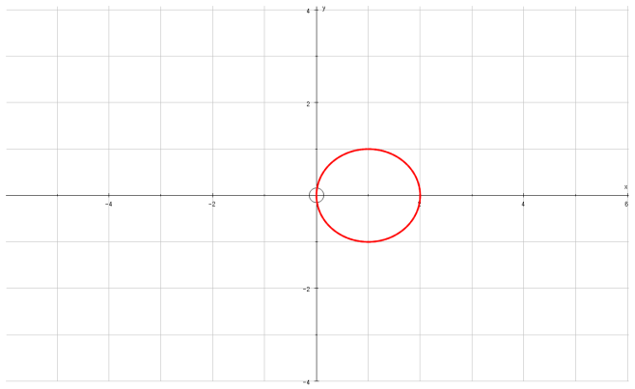
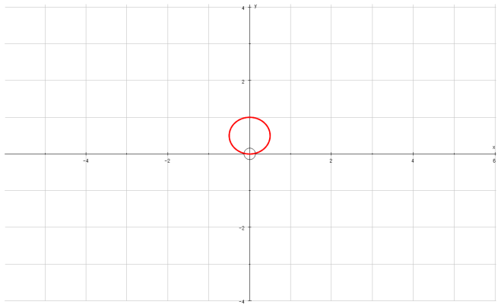
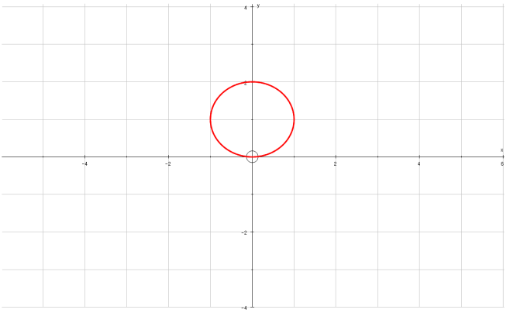
Polar Coordinates
You can sketch curves based on their Polar equations
You don’t need to memorise these shapes, but they are useful to be aware of (in addition to those you have seen so far…)
$$r=cosθ$$
$$r=2cosθ$$
$$r=4cosθ$$
$$r=sinθ$$
$$r=2sinθ$$
$$r=4sinθ$$
7C

Slide 45
Teachings for
Exercise 7D

Slide 46
Polar Coordinates
$$Area=\frac{1}{2}\int_{α}^{β}{r^{2} dθ}$$
π 2
π 3
You can use Integration to find areas of sectors of curves, given their Polar equations
The process is similar to that of regular Integration for finding an area.
To find the area enclosed by the curve, and the half lines θ = α and θ = β, you can use the formula below:
(you might notice the ¹/₂r²θ being familiar as the formula for the area of a sector from C2!)
π 6
π
0, 2π
$$Area=\frac{1}{2}\int_{α}^{β}{r^{2} dθ}$$
$$r=1+cosθ$$
3π 2
So for the example above, we would calculate the shaded area by doing:
$$=\frac{1}{2}\int_{\frac{π}{6}}^{\frac{π}{3}}{{\left(1+cosθ\right)}^{2} dθ}$$
7D

Slide 47
Polar Coordinates
$$Area=\frac{1}{2}\int_{α}^{β}{r^{2} dθ}$$
π 2
You can use Integration to find areas of sectors of curves, given their Polar equations
Find the area enclosed by the cardioid with equation:
r = a(1 + cosθ)
Sketch the graph (you won’t always be asked to do this, but you should do as it helps visualise the question…)
We are going to find the area enclosed by the curve
→ As the curve has reflective symmetry, we can find the area above the x-axis, then double it…
π
0
π
0, 2π
3π 2
So for this question:
$$r=a(1+cosθ)$$
$$α=0$$
$$β=π$$
We will now substitute these into the formula for the area, given earlier:
$$Area=\frac{1}{2}\int_{α}^{β}{r^{2} dθ}$$
7D

Slide 48
Polar Coordinates
$$Area=\frac{1}{2}\int_{α}^{β}{r^{2} dθ}$$
$$\frac{1}{2}\int_{α}^{β}{r^{2} dθ}$$
You can use Integration to find areas of sectors of curves, given their Polar equations
Find the area enclosed by the cardioid with equation:
r = a(1 + cosθ)
Sketch the graph (you won’t always be asked to do this, but you should do as it helps visualise the question…)
As we will be doubling our answer at the end, we can just remove the ‘¹/₂’ now to save us doing it later!
$$\int_{α}^{β}{r^{2} dθ}$$
Sub in values
$$\int_{0}^{π}{{\left(a\left(1+cosθ\right)\right)}^{2} dθ}$$
Square it all
$$\int_{0}^{π}{a^{2}{\left(1+cosθ\right)}^{2} dθ}$$
You can put the ‘a²’ term outside the integral, since it is a constant
$$a^{2}\int_{0}^{π}{{\left(1+cosθ\right)}^{2} dθ}$$
Multiply the bracket out
$$r=a(1+cosθ)$$
$$a^{2}\int_{0}^{π}{1+2cosθ+\cos^{2}θ dθ}$$
$$α=0$$
$$β=π$$
We will need to rewrite the cos² term so we can integrate it (using ‘standard patterns’ from C4 will not work here as we would get additional terms other than cos…)
7D

Slide 49
Polar Coordinates
$$Area=\frac{1}{2}\int_{α}^{β}{r^{2} dθ}$$
$$cos2θ=2\cos^{2}θ−1$$
$$a^{2}\int_{0}^{π}{1+2cosθ+\cos^{2}θ dθ}$$
You can use Integration to find areas of sectors of curves, given their Polar equations
Find the area enclosed by the cardioid with equation:
r = a(1 + cosθ)
Sketch the graph (you won’t always be asked to do this, but you should do as it helps visualise the question…)
Replace cos²θ
$$a^{2}\int_{0}^{π}{1+2cosθ+\frac{1}{2}cos2θ+\frac{1}{2} dθ}$$
Group like terms
$$a^{2}\int_{0}^{π}{\frac{3}{2}+2cosθ+\frac{1}{2}cos2θ dθ}$$
Now we can think about actually Integrating!
To replace cos²θ, we can use the formula for cos2θ from C3…
$$cos2θ=2\cos^{2}θ−1$$
$$r=a(1+cosθ)$$
Add 1
$$cos2θ+1=2\cos^{2}θ$$
$$α=0$$
$$β=π$$
Divide by 2
$$\frac{1}{2}cos2θ+\frac{1}{2}=\cos^{2}θ$$
7D

Slide 50
Polar Coordinates
$$Area=\frac{1}{2}\int_{α}^{β}{r^{2} dθ}$$
$$cos2θ=2\cos^{2}θ−1$$
$$a^{2}\int_{0}^{π}{1+2cosθ+\cos^{2}θ dθ}$$
You can use Integration to find areas of sectors of curves, given their Polar equations
Find the area enclosed by the cardioid with equation:
r = a(1 + cosθ)
Sketch the graph (you won’t always be asked to do this, but you should do as it helps visualise the question…)
Replace cos²θ
$$a^{2}\int_{0}^{π}{1+2cosθ+\frac{1}{2}cos2θ+\frac{1}{2} dθ}$$
Group like terms
$$a^{2}\int_{0}^{π}{\frac{3}{2}+2cosθ+\frac{1}{2}cos2θ dθ}$$
Integrate each term with respect to θ, using the ‘standard patterns’ technique
ie) Think about what would differentiate to give these, then adjust it to give the correct coefficient
$${\left[\begin{matrix} \\ \end{matrix} \right]}_{0}^{π}$$
$$a^{2}$$
$$\frac{3}{2}θ$$
$$+ 2sinθ$$
$$+ \frac{1}{4}sin2θ$$
Sub π in and 0 in separately, and subtract
$$\frac{3}{2}π+0+0$$
$$−\left(\begin{matrix} \\ \end{matrix} \right)$$
$$a^{2}$$
$$0+0+0$$
$$r=a(1+cosθ)$$
$$α=0$$
$$β=π$$
Calculate
$$\frac{3πa^{2}}{2}$$
Show full workings, even if it takes a while. It is very easy to make mistakes here!
7D

Slide 51
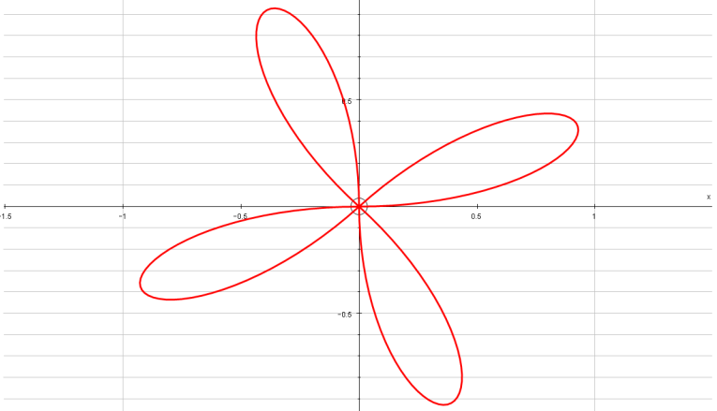
Polar Coordinates
$$Area=\frac{1}{2}\int_{α}^{β}{r^{2} dθ}$$
Think about plotting r = asin4θ
You can use Integration to find areas of sectors of curves, given their Polar equations
Find the area of one loop of the curve with polar equation:
r = asin4θ
Start by sketching it…
From the patterns you have seen, you might recognise that this will have 4 ‘loops’
1
Sinθ
0
-1
^{π}/₂
π
^{3π}/₂
2π
→ From the Sine graph, you can see that r will be positive between 0 and π
As the graph repeats, r will also be positive between 2π and 3π, 4π and 5π, and 6π and 7π
So we would plot r for the following ranges of 4θ
0 ≤ 4θ ≤ π
2π ≤ 4θ ≤ 3π
4π ≤ 4θ ≤ 5π
6π ≤ 4θ ≤ 7π
0 ≤ θ ≤ ^{π}/₄
^{π}/₂ ≤ θ ≤ ^{3π}/₄
π ≤ θ ≤ ^{5π}/₄
^{3π}/₂ ≤ θ ≤ ^{7π}/₄
^{3π}/₄
^{π}/₂
^{π}/₄
Sometimes it helps to plot the ‘limits’ for positive values of r on your diagram!
π
0
^{5π}/₄
^{3π}/₂
^{7π}/₄
7D

Slide 52
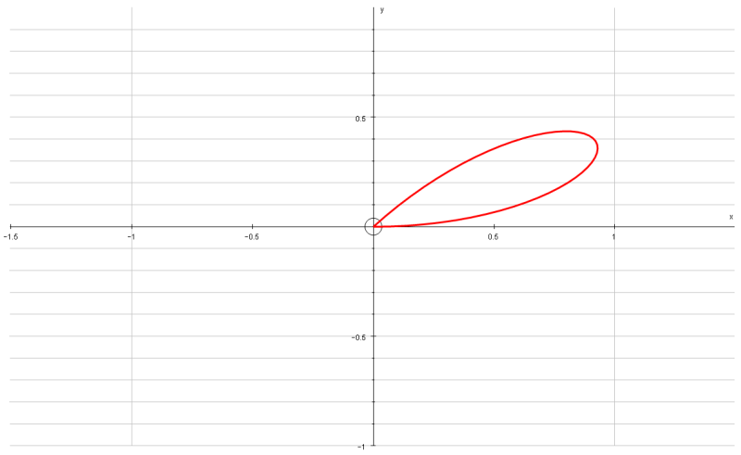
Polar Coordinates
$$Area=\frac{1}{2}\int_{α}^{β}{r^{2} dθ}$$
^{3π}/₄
^{π}/₂
^{π}/₄
You can use Integration to find areas of sectors of curves, given their Polar equations
Find the area of one loop of the curve with polar equation:
r = asin4θ
Start by sketching it…
From the patterns you have seen, you might recognise that this will have 4 ‘loops’
We only need to sketch one loop as this is what we need to find the area of (so this saves time!)
π
0
^{5π}/₄
^{3π}/₂
^{7π}/₄
So the values we need to use for one loop are:
$$r=asin4θ$$
$$α=0$$
$$β=\frac{π}{4}$$
We will substitute these into the formula for the area…
$$Area=\frac{1}{2}\int_{α}^{β}{r^{2} dθ}$$
7D

Slide 53
Polar Coordinates
$$Area=\frac{1}{2}\int_{α}^{β}{r^{2} dθ}$$
$$\frac{1}{2}\int_{α}^{β}{r^{2} dθ}$$
You can use Integration to find areas of sectors of curves, given their Polar equations
Find the area of one loop of the curve with polar equation:
r = asin4θ
Replace r and the limits we worked out
$$\frac{1}{2}\int_{0}^{\frac{π}{4}}{{\left(asin4θ\right)}^{2} dθ}$$
Square the bracket
$$\frac{1}{2}\int_{0}^{\frac{π}{4}}{a^{2}\sin^{2}4θ dθ}$$
Similar to last time, you can take the ‘a²’ term and put it outside the integral
$$\frac{1}{2}a^{2}\int_{0}^{\frac{π}{4}}{\sin^{2}4θ dθ}$$
$$r=asin4θ$$
$$α=0$$
$$β=\frac{π}{4}$$
We will need to write sin²4θ so that we can integrate it (by writing is as sin or cos without any powers)
7D

Slide 54
Polar Coordinates
$$Area=\frac{1}{2}\int_{α}^{β}{r^{2} dθ}$$
$$cos2θ=1−2\sin^{2}θ$$
$$\frac{1}{2}a^{2}\int_{0}^{\frac{π}{4}}{\sin^{2}4θ dθ}$$
You can use Integration to find areas of sectors of curves, given their Polar equations
Find the area of one loop of the curve with polar equation:
r = asin4θ
Replace sin²4θ
$$\frac{1}{2}a^{2}\int_{0}^{\frac{π}{4}}{\frac{1}{2}(1−cos8θ) dθ}$$
Before integrating, you can take the ‘¹/₂’ outside the integral as well…
$$\frac{1}{4}a^{2}\int_{0}^{\frac{π}{4}}{1−cos8θ dθ}$$
$$β=\frac{π}{4}$$
Now this has been set up, we can actually Integrate it!
$$r=asin4θ$$
$$α=0$$
To replace sin²4θ, we can use another formula for cos2θ from C3…
$$cos2θ=1−2\sin^{2}θ$$
Rearrange
$$2\sin^{2}θ=1−cos2θ$$
$$\sin^{2}θ=\frac{1}{2}\left(1−cos2θ\right)$$
Divide by 2
Multiply the θ terms by 4
$$\sin^{2}4θ=\frac{1}{2}(1−cos8θ)$$
7D

Slide 55
Polar Coordinates
$$Area=\frac{1}{2}\int_{α}^{β}{r^{2} dθ}$$
$$cos2θ=1−2\sin^{2}θ$$
$$\frac{1}{2}a^{2}\int_{0}^{\frac{π}{4}}{\sin^{2}4θ dθ}$$
You can use Integration to find areas of sectors of curves, given their Polar equations
Find the area of one loop of the curve with polar equation:
r = asin4θ
Replace sin²4θ
$$\frac{1}{2}a^{2}\int_{0}^{\frac{π}{4}}{\frac{1}{2}(1−cos8θ) dθ}$$
Before integrating, you can take the ‘¹/₂’ outside the integral as well…
$$\frac{1}{4}a^{2}\int_{0}^{\frac{π}{4}}{1−cos8θ dθ}$$
Integrate using the ‘standard patterns’ technique
$$β=\frac{π}{4}$$
$$\frac{1}{4}a^{2}{\left[θ−\frac{1}{8}sin8θ\right]}_{0}^{\frac{π}{4}}$$
$$r=asin4θ$$
$$α=0$$
Sub in ^{π}/₄ (subbing in 0 will cancel all terms, so we don’t really need to work this part out
→ Remember that if you have ‘cos’, you would need to sub in 0!
$$\frac{1}{4}a^{2}\left[\frac{π}{4}−\frac{1}{8}sin2π\right]$$
Work out the exact value
$$=\frac{{πa}^{2}}{16}$$
Important points:
You sometimes have to do a lot of rearranging/substitution before you can Integrate
Your calculator might not give you exact values, so you need to find them yourself by manipulating the fractions
7D

Slide 56
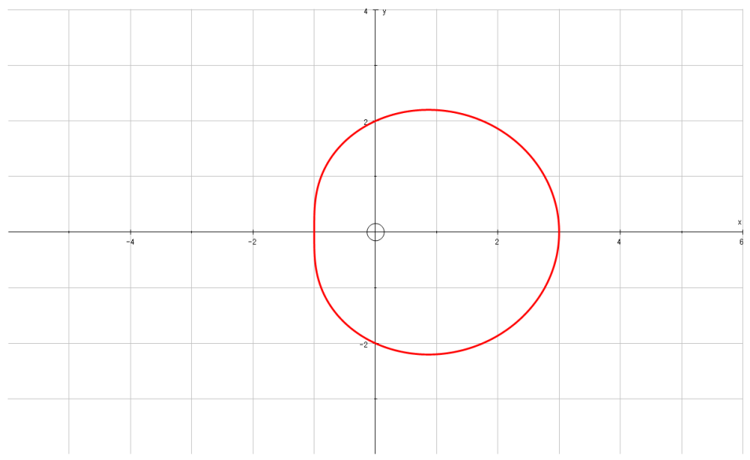
Polar Coordinates
$$Area=\frac{1}{2}\int_{α}^{β}{r^{2} dθ}$$
π 2
You can use Integration to find areas of sectors of curves, given their Polar equations
a) On the same diagram, sketch the curves with equations:
r = 2 + cosθ
r = 5cosθ
b) Find the polar coordinates of the intersection of these curves
c) Find the exact value of the finite region bounded by the 2 curves
2
$$r=2+cosθ$$
π
1
3
0, 2π
2
3π 2
Start by plotting the graph of r = 2 + cosθ
→ Use a table if it helps, to work out values when θ is 0, ^{π}/₂, π and ^{3π}/₂
7D

Slide 57
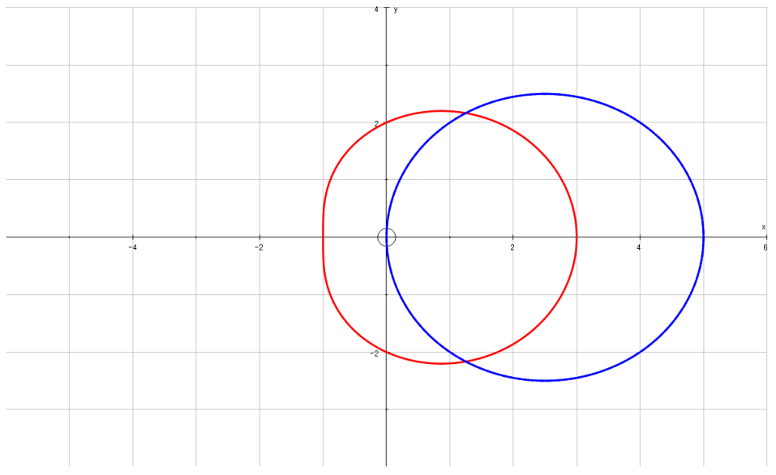
Polar Coordinates
$$Area=\frac{1}{2}\int_{α}^{β}{r^{2} dθ}$$
π 2
You can use Integration to find areas of sectors of curves, given their Polar equations
a) On the same diagram, sketch the curves with equations:
r = 2 + cosθ
r = 5cosθ
b) Find the polar coordinates of the intersection of these curves
c) Find the exact value of the finite region bounded by the 2 curves
(^{π}/₄,^{5√2}/₂)
2
$$r=2+cosθ$$
π
0
5
1
3
0, 2π
2
$$r=5cosθ$$
(^{7π}/₄,^{5√2}/₂)
3π 2
Now plot the graph of r = 5cosθ
A Cos graph may be useful here as some values will be undefined…
Work out values of cos for 0, ^{π}/₄ and ^{π}/₂, as well as ^{3π}/₂, ^{7π}/₄ and 2π
(this way we will have enough points to use to work out the shape…)
1
Cosθ
0
-1
^{π}/₂
π
^{3π}/₂
2π
7D

Slide 58
Polar Coordinates
$$Area=\frac{1}{2}\int_{α}^{β}{r^{2} dθ}$$
π 2
You can use Integration to find areas of sectors of curves, given their Polar equations
a) On the same diagram, sketch the curves with equations:
r = 2 + cosθ
r = 5cosθ
b) Find the polar coordinates of the intersection of these curves
c) Find the exact value of the finite region bounded by the 2 curves
(2.5,^{π}/₃)
$$r=2+cosθ$$
π
0, 2π
$$r=5cosθ$$
(2.5,-^{π}/₃)
3π 2
To find the intersection, we can use the two equations we were given:
$$2+cosθ=5cosθ$$
Subtract cosθ
Using these values of θ, we can work out that r = 2.5 at these points
$$2=4cosθ$$
Divide by 4
$$0.5=cosθ$$
Inverse cos (and work out the other possible answer)
$$θ=\frac{π}{3}, −\frac{π}{3}$$
7D

Slide 59
Polar Coordinates
$$Area=\frac{1}{2}\int_{α}^{β}{r^{2} dθ}$$
π 2
You can use Integration to find areas of sectors of curves, given their Polar equations
a) On the same diagram, sketch the curves with equations:
r = 2 + cosθ
r = 5cosθ
b) Find the polar coordinates of the intersection of these curves
c) Find the exact value of the finite region bounded by the 2 curves
(2.5,^{π}/₃)
$$r=2+cosθ$$
π
0, 2π
$$r=5cosθ$$
(2.5,-^{π}/₃)
3π 2
The region we are finding the area of is highlighted in green
→ We can calculate the area of just the top part, and then double it (since the area is symmetrical)
7D

Slide 60
Polar Coordinates
$$Area=\frac{1}{2}\int_{α}^{β}{r^{2} dθ}$$
π 2
π 3
You can use Integration to find areas of sectors of curves, given their Polar equations
a) On the same diagram, sketch the curves with equations:
r = 2 + cosθ
r = 5cosθ
b) Find the polar coordinates of the intersection of these curves
c) Find the exact value of the finite region bounded by the 2 curves
$$r=2+cosθ$$
π
0
$$r=5cosθ$$
3π 2
You need to imagine the top part as two separate sections
Draw on the ‘limits’, and a line through the intersection, and you can see that this is two different areas
The area under the red curve with limits 0 and ^{π}/₃
The area under the blue curve with limits ^{π}/₃ and ^{π}/₂
We need to work both of these out and add them together!
7D

Slide 61
Polar Coordinates
$$Area=\frac{1}{2}\int_{α}^{β}{r^{2} dθ}$$
π 2
π 3
You can use Integration to find areas of sectors of curves, given their Polar equations
a) On the same diagram, sketch the curves with equations:
r = 2 + cosθ
r = 5cosθ
b) Find the polar coordinates of the intersection of these curves
c) Find the exact value of the finite region bounded by the 2 curves
$$r=2+cosθ$$
π
0
$$r=5cosθ$$
3π 2
For the red curve:
For the blue curve:
$$r=2+cosθ$$
$$r=5cosθ$$
$$α=0$$
$$α=\frac{π}{3}$$
$$β=\frac{π}{3}$$
$$β=\frac{π}{2}$$
7D

Slide 62
Polar Coordinates
$$Area=\frac{1}{2}\int_{α}^{β}{r^{2} dθ}$$
$$cos2θ=2\cos^{2}θ−1$$
For the red curve:
For the blue curve:
You can use Integration to find areas of sectors of curves, given their Polar equations
a) On the same diagram, sketch the curves with equations:
r = 2 + cosθ
r = 5cosθ
b) Find the polar coordinates of the intersection of these curves
c) Find the exact value of the finite region bounded by the 2 curves
→ Red curve first! Sub the values into the area equation
$$r=2+cosθ$$
$$r=5cosθ$$
$$α=0$$
$$β=\frac{π}{3}$$
$$α=\frac{π}{3}$$
$$β=\frac{π}{2}$$
$$\frac{1}{2}\int_{α}^{β}{r^{2} dθ}$$
Sub in the values from above
→ Also, remove the ‘¹/₂’ since we will be doubling our answer anyway!
$$\int_{0}^{\frac{π}{3}}{{\left(2+cosθ\right)}^{2} dθ}$$
$$\int_{0}^{\frac{π}{3}}{4+4cosθ+\cos^{2}θ dθ}$$
Square the bracket
Replace the cos²θ term with an equivalent expression (using the equation for cos2θ above)
$$\int_{0}^{\frac{π}{3}}{ 4+4cosθ+\frac{1}{2}cos2θ+\frac{1}{2} dθ}$$
Group like terms, and then we can integrate!
$$\int_{0}^{\frac{π}{3}}{ \frac{9}{2}+4cosθ+\frac{1}{2}cos2θ dθ}$$
7D

Slide 63
Polar Coordinates
$$Area=\frac{1}{2}\int_{α}^{β}{r^{2} dθ}$$
$$cos2θ=2\cos^{2}θ−1$$
For the red curve:
For the blue curve:
You can use Integration to find areas of sectors of curves, given their Polar equations
a) On the same diagram, sketch the curves with equations:
r = 2 + cosθ
r = 5cosθ
b) Find the polar coordinates of the intersection of these curves
c) Find the exact value of the finite region bounded by the 2 curves
→ Red curve first! Sub the values into the area equation
$$r=2+cosθ$$
$$r=5cosθ$$
$$α=0$$
$$β=\frac{π}{3}$$
$$α=\frac{π}{3}$$
$$β=\frac{π}{2}$$
$$\int_{0}^{\frac{π}{3}}{ \frac{9}{2}+4cosθ+\frac{1}{2}cos2θ dθ}$$
Integrate each term, using ‘standard patterns’ where needed…
$${\left[\frac{9}{2}θ+4sinθ+\frac{1}{4}sin2θ\right]}_{0}^{\frac{π}{3}}$$
Sub in the limits separately (as subbing in 0 will give 0 overall here, we can just ignore it!)
$$\frac{9}{2}\left(\frac{π}{3}\right)+4sin\left(\frac{π}{3}\right)+\frac{1}{4}sin\left(\frac{2π}{3}\right)$$
Calculate each part (your calculator may give you a decimal answer if you type the whole sum in)
$$\frac{3π}{2}+2\sqrt{3}+\frac{\sqrt{3}}{8}$$
Write with a common denominator
$$\frac{12π}{8}+\frac{16\sqrt{3}}{8}+\frac{\sqrt{3}}{8}$$
Group up
$$\frac{12π+17\sqrt{3}}{8}$$
7D

Slide 64
Polar Coordinates
$$Area=\frac{1}{2}\int_{α}^{β}{r^{2} dθ}$$
$$cos2θ=2\cos^{2}θ−1$$
For the red curve:
For the blue curve:
You can use Integration to find areas of sectors of curves, given their Polar equations
a) On the same diagram, sketch the curves with equations:
r = 2 + cosθ
r = 5cosθ
b) Find the polar coordinates of the intersection of these curves
c) Find the exact value of the finite region bounded by the 2 curves
→ Now we can do the same for the blue part…
$$r=5cosθ$$
$$Area=\frac{12π+17\sqrt{3}}{8}$$
$$α=\frac{π}{3}$$
$$β=\frac{π}{2}$$
$$\frac{1}{2}\int_{α}^{β}{r^{2} dθ}$$
Sub in the values from above
→ Also, remove the ‘¹/₂’ since we will be doubling our answer anyway!
$$\int_{\frac{π}{3}}^{\frac{π}{2}}{{\left(5cosθ\right)}^{2} dθ}$$
$$\int_{\frac{π}{3}}^{\frac{π}{2}}{25\cos^{2}θ dθ}$$
Square the bracket
Replace the cos²θ term with an equivalent expression (using the equation for cos 2θ above)
$$\int_{\frac{π}{3}}^{\frac{π}{2}}{ 25\left(\frac{1}{2}cos2θ+\frac{1}{2}\right) dθ}$$
We can move the ‘¹/₂’ and the 25 outside to make the integration a little easier
$$\frac{25}{2}\int_{\frac{π}{3}}^{\frac{π}{2}}{ cos2θ+1 dθ}$$
7D

Slide 65
Polar Coordinates
$$Area=\frac{1}{2}\int_{α}^{β}{r^{2} dθ}$$
$$cos2θ=2\cos^{2}θ−1$$
For the red curve:
For the blue curve:
You can use Integration to find areas of sectors of curves, given their Polar equations
a) On the same diagram, sketch the curves with equations:
r = 2 + cosθ
r = 5cosθ
b) Find the polar coordinates of the intersection of these curves
c) Find the exact value of the finite region bounded by the 2 curves
→ Now we can do the same for the blue part…
$$r=5cosθ$$
$$Area=\frac{12π+17\sqrt{3}}{8}$$
$$α=\frac{π}{3}$$
$$β=\frac{π}{2}$$
$$\frac{25}{2}\int_{\frac{π}{3}}^{\frac{π}{2}}{ cos2θ+1 dθ}$$
Integrate each term, using ‘standard patterns’ if needed…
$$\frac{25}{2}{\left[\frac{1}{2}sin2θ+θ\right]}_{\frac{π}{3}}^{\frac{π}{2}}$$
Sub in the limits (we do need to include both this time as neither will cancel a whole section out!)
$$\frac{25}{2}\left[\left(\frac{1}{2}sinπ+\frac{π}{2}\right)−\left(\frac{1}{2}sin\frac{2π}{3}+\frac{π}{3}\right)\right]$$
Calculate each part as an exact value
$$\frac{25}{2}\left[\left(\frac{π}{2}\right)−\left(\frac{\sqrt{3}}{4}+\frac{π}{3}\right)\right]$$
Write with common denominators
$$\frac{25}{2}\left[\left(\frac{6π}{12}\right)−\left(\frac{3\sqrt{3}}{12}+\frac{4π}{12}\right)\right]$$
Group up and multiply by ²⁵/₂
$$\frac{50π−75\sqrt{3}}{24}$$
7D

Slide 66
Polar Coordinates
$$Area=\frac{1}{2}\int_{α}^{β}{r^{2} dθ}$$
$$cos2θ=2\cos^{2}θ−1$$
For the red curve:
For the blue curve:
You can use Integration to find areas of sectors of curves, given their Polar equations
a) On the same diagram, sketch the curves with equations:
r = 2 + cosθ
r = 5cosθ
b) Find the polar coordinates of the intersection of these curves
c) Find the exact value of the finite region bounded by the 2 curves
$$Area=\frac{12π+17\sqrt{3}}{8}$$
$$Area=\frac{50π−75\sqrt{3}}{24}$$
Add these two areas together to get the total area!
$$\frac{12π+17\sqrt{3}}{8}+\frac{50π−75\sqrt{3}}{24}$$
Write with a common denominator
$$\frac{36π+51\sqrt{3}}{24}+\frac{50π−75\sqrt{3}}{24}$$
Add the numerators
$$\frac{86π−24\sqrt{3}}{24}$$
Divide all by 2
$$\frac{43π−12\sqrt{3}}{12}$$
These questions are often worth a lot of marks!
Your calculate might not give you exact values for long sums, so you will need to be able to deal with the surds and fractions yourself!
7D

Slide 67
Teachings for
Exercise 7E

Slide 68
Polar Coordinates
$$\frac{dy}{dθ}=0$$
$$Parallel to the initial line$$
You saw these two equations linking the Cartesian and polar forms in section 7A
You can use the Polar equation to find tangents to a curve that are parallel or perpendicular to the original line
We have looked at integration to find areas beneath polar curves
This final section looks at differentiating to find tangents to polar curves
It is very similar to what you have done already – ie) Differentiating and setting the expression equal to 0
With polar equations we use them in a parametric form to make the process more straightforward…
$$y=rsinθ$$
$$x=rcosθ$$
The line from the origin at an angle of 0 is called the ‘initial line’
$$\frac{dy}{dθ}=0$$
$$\frac{dy}{dθ}=0$$
The equation y = rsinθ represents changes in the vertical direction
When ^{dy}/_{dθ} is 0, that means that there is no movement in the vertical direction (the change in y with respect to a change in θ is 0)
→ Therefore, if ^{dy}/_{dθ} is 0, the curve is parallel to the ‘initial line’
7E

Slide 69
Polar Coordinates
$$\frac{dy}{dθ}=0$$
$$Parallel to the initial line$$
$$\frac{dx}{dθ}=0$$
$$Perpendicular to the initial line$$
You saw these two equations linking the Cartesian and polar forms in section 7A
You can use the Polar equation to find tangents to a curve that are parallel or perpendicular to the original line
We have looked at integration to find areas beneath polar curves
This final section looks at differentiating to find tangents to polar curves
It is very similar to what you have done already – ie) Differentiating and setting the expression equal to 0
With polar equations we use them in a parametric form to make the process more straightforward…
$$y=rsinθ$$
$$x=rcosθ$$
The line from the origin at an angle of 0 is called the ‘initial line’
$$\frac{dx}{dθ}=0$$
$$\frac{dx}{dθ}=0$$
The equation x = rcosθ represents changes in the horizontal direction
When ^{dx}/_{dθ} is 0, that means that there is no movement in the horizontal direction (the change in x with respect to a change in θ is 0)
→ Therefore, if ^{dy}/_{dθ} is 0, the curve is perpendicular to the ‘initial line’
7E

Slide 70
Polar Coordinates
$$\frac{dy}{dθ}=0$$
$$Parallel to the initial line$$
$$\frac{dx}{dθ}=0$$
$$Perpendicular to the initial line$$
$$x=rcosθ$$
$$y=rsinθ$$
You can use the Polar equation to find tangents to a curve that are parallel or perpendicular to the original line
Find the coordinates of the points on:
r = a(1 + cosθ)
Where the tangents are parallel to the initial line θ = 0.
You need to find an expression for y in terms of θ, before you can use the rules above
$$r=a(1+cosθ)$$
Rearrange
$$\frac{y}{sinθ}=r$$
$$y=rsinθ$$
You can substitute this into the equation of the curve to eliminate r
$$r=a(1+cosθ)$$
Replace r with a term in y and θ
$$\frac{y}{sinθ}=a(1+cosθ)$$
Multiply by sinθ
$$y=asinθ(1+cosθ)$$
Leave ‘a’ outside the bracket (it is a constant)
$$y=a(sinθ+sinθcosθ)$$
7E

Slide 71
Polar Coordinates
$$\frac{dy}{dθ}=0$$
$$Parallel to the initial line$$
$$\frac{dx}{dθ}=0$$
$$Perpendicular to the initial line$$
$$x=rcosθ$$
$$y=rsinθ$$
$$y=a(sinθ+sinθcosθ)$$
Differentiate, using the product rule where necessary
→ (alternatively, sinθcosθ could be written as ¹/₂sin2θ first, which then avoids the need for the product rule)
You can use the Polar equation to find tangents to a curve that are parallel or perpendicular to the original line
Find the coordinates of the points on:
r = a(1 + cosθ)
Where the tangents are parallel to the initial line θ = 0.
Now differentiate
You can just differentiate the terms inside the bracket, since a is a constant and will just remain the same!
$$\frac{dy}{dθ}=a( )$$
$$cosθ$$
$$+ \cos^{2}θ$$
$$− \sin^{2}θ$$
Product rule for sinθcosθ
If ^{dy}/_{dθ} is 0, then the expression in the brackets must be 0 (‘a’ cannot be as it is a constant)
$$sinθ$$
$$cosθ$$
$$c{os}^{2}θ+cosθ−s{in}^{2}θ=0$$
Replace the term in sin with one in cos (from C2)
$$cosθ$$
$$−sinθ$$
$$c{os}^{2}θ+cosθ−(1−c{os}^{2}θ)=0$$
Group terms
$$2c{os}^{2}θ+cosθ−1=0$$
Factorise
$$(2cosθ−1)(cosθ+1)=0$$
$$cosθ=\frac{1}{2} or cosθ=−1$$
7E

Slide 72
Polar Coordinates
$$\frac{dy}{dθ}=0$$
$$Parallel to the initial line$$
$$\frac{dx}{dθ}=0$$
$$Perpendicular to the initial line$$
$$x=rcosθ$$
$$y=rsinθ$$
$$cosθ=\frac{1}{2} or cosθ=−1$$
You can use the Polar equation to find tangents to a curve that are parallel or perpendicular to the original line
Find the coordinates of the points on:
r = a(1 + cosθ)
Where the tangents are parallel to the initial line θ = 0.
Find θ in the range 0 ≤ θ < 2π
Find θ in the range 0 ≤ θ < 2π
$$θ=\frac{π}{3} or −\frac{π}{3}$$
Use these to find r so you have the full coordinates
$$θ=π$$
$$r=0$$
$$r=\frac{3a}{2} (for both)$$
So the curve is parallel to the initial line in these positions:
$$\left(\frac{3a}{2},±\frac{π}{3}\right) and \left(0,π\right)$$
(^{3a}/₂,^{π}/₃)
$$r=a(1+cosθ)$$
(0,π)
(^{3a}/₂,-^{π}/₃)
7E

Slide 73
Polar Coordinates
$$\frac{dy}{dθ}=0$$
$$Parallel to the initial line$$
$$\frac{dx}{dθ}=0$$
$$Perpendicular to the initial line$$
$$x=rcosθ$$
$$y=rsinθ$$
You can use the Polar equation to find tangents to a curve that are parallel or perpendicular to the original line
Find the coordinates and the equations of the tangents to the curve:
r = asin2θ, 0 ≤ θ ≤ ^{π}/₂
Where the tangents are:
Parallel to the initial line
Perpendicular to the initial line
Give answers to 3 s.f where appropriate:
→ Sketch it to get an idea of where the tangents will be…
So we need to find the equations of the tangents that are parallel to the initial line
^{dy}/_{dθ} = 0
As in the previous example, we will need to find an expression for y
$$y=rsinθ$$
You can actually substitute r straight in if you want to (this was also an option on the previous example!)
$$y=asin2θsinθ$$
7E

Slide 74
Polar Coordinates
$$\frac{dy}{dθ}=0$$
$$Parallel to the initial line$$
$$\frac{dx}{dθ}=0$$
$$Perpendicular to the initial line$$
$$x=rcosθ$$
$$y=rsinθ$$
You can use the Polar equation to find tangents to a curve that are parallel or perpendicular to the original line
Find the coordinates and the equations of the tangents to the curve:
r = asin2θ, 0 ≤ θ ≤ ^{π}/₂
Where the tangents are:
Parallel to the initial line
Perpendicular to the initial line
Give answers to 3 s.f where appropriate:
→ Now we can differentiate
$$y=a(sin2θsinθ)$$
Product rule for sinθcosθ
$$\frac{dy}{dθ}=$$
$$a($$
$$)$$
$$sin2θ$$
$$sinθ$$
$$sin2θcosθ$$
$$+ 2cos2θsinθ$$
If ^{dy}/_{dθ} = 0, then the part in the bracket must be 0
$$2cos2θ$$
$$cosθ$$
$$sin2θcosθ+2cos2θsinθ=0$$
Replace sin2θ and cos2θ with equivalent expressions from C3
$$2sinθcosθcosθ$$
$$+ 2\left(2\cos^{2}θ−1\right)sinθ=0$$
Simplify/Multiply out brackets
$$2sinθcos^{2}θ+4\cos^{2}θsinθ−2sinθ=0$$
Group terms
$$6sinθcos^{2}θ−2sinθ=0$$
Factorise
$$2sinθ(3cos^{2}θ−1)=0$$
Solve in the range you’re given
$$2sinθ=0$$
$$\cos^{2}θ=\frac{1}{3}$$
$$θ=0$$
$$cosθ=\frac{1}{\sqrt{3}}$$
$$θ=0.955$$
7E

Slide 75
Polar Coordinates
$$\frac{dy}{dθ}=0$$
$$Parallel to the initial line$$
$$\frac{dx}{dθ}=0$$
$$Perpendicular to the initial line$$
$$x=rcosθ$$
$$y=rsinθ$$
You can use the Polar equation to find tangents to a curve that are parallel or perpendicular to the original line
Find the coordinates and the equations of the tangents to the curve:
r = asin2θ, 0 ≤ θ ≤ ^{π}/₂
Where the tangents are:
Parallel to the initial line
Perpendicular to the initial line
Give answers to 3 s.f where appropriate:
→ You can find the value of r for each, and use the sketch to find the equation of the tangent
$$θ=0 or θ=0.955$$
(^{2a√2}/₃,0.955)
$$r=0 or r=\frac{2a\sqrt{2}}{3}$$
$$θ=0$$
(0,0)
The equation of this line is just:
$$θ=0$$
7E

Slide 76
Polar Coordinates
$$\frac{dy}{dθ}=0$$
$$Parallel to the initial line$$
$$\frac{dx}{dθ}=0$$
$$Perpendicular to the initial line$$
$$x=rcosθ$$
$$y=rsinθ$$
You can use the Polar equation to find tangents to a curve that are parallel or perpendicular to the original line
Find the coordinates and the equations of the tangents to the curve:
r = asin2θ, 0 ≤ θ ≤ ^{π}/₂
Where the tangents are:
Parallel to the initial line
Perpendicular to the initial line
Give answers to 3 s.f where appropriate:
$$θ=0 or θ=0.955$$
(^{2a√2}/₃,0.955)
$$r=0 or r=\frac{2a\sqrt{2}}{3}$$
$$θ=0$$
$$cosθ=\frac{1}{\sqrt{3}}$$
$$sinθ=\frac{\sqrt{2}}{\sqrt{3}}$$
We need to find the equation of the line above (in polar form…)
→ A couple of trig ratios will be useful to us here. We already know that for this point:
$$cosθ=\frac{1}{\sqrt{3}}$$
$$\left(\frac{Adj}{Hyp}\right)$$
Hyp
√3
√2
Opp
$$sinθ=\frac{\sqrt{2}}{\sqrt{3}}$$
$$\left(\frac{Opp}{Hyp}\right)$$
θ
1
Adj
7E

Slide 77
Polar Coordinates
$$\frac{dy}{dθ}=0$$
$$Parallel to the initial line$$
$$\frac{dx}{dθ}=0$$
$$Perpendicular to the initial line$$
$$x=rcosθ$$
$$y=rsinθ$$
You can use the Polar equation to find tangents to a curve that are parallel or perpendicular to the original line
Find the coordinates and the equations of the tangents to the curve:
r = asin2θ, 0 ≤ θ ≤ ^{π}/₂
Where the tangents are:
Parallel to the initial line
Perpendicular to the initial line
Give answers to 3 s.f where appropriate:
$$θ=0 or θ=0.955$$
(^{2a√2}/₃,0.955)
$$r=0 or r=\frac{2a\sqrt{2}}{3}$$
^{2a√2}/₃
Opp
$$θ=0$$
θ
$$cosθ=\frac{1}{\sqrt{3}}$$
$$sinθ=\frac{\sqrt{2}}{\sqrt{3}}$$
You can find the equation of the line in Cartesian form, then substitute it into the link between y and r above
The Cartesian form will just be y = a, where a is the height of the line
$$Opp=Hyp×Sinθ$$
$$Opp=\frac{2a\sqrt{2}}{3}×\frac{\sqrt{2}}{\sqrt{3}}$$
Sub in values
Calculate
$$Opp=\frac{4a}{3\sqrt{3}}$$
So this is the Cartesian equation of the tangent…
$$y=\frac{4a}{3\sqrt{3}}$$
7E

Slide 78
Polar Coordinates
$$\frac{dy}{dθ}=0$$
$$Parallel to the initial line$$
$$\frac{dx}{dθ}=0$$
$$Perpendicular to the initial line$$
$$x=rcosθ$$
$$y=rsinθ$$
You can use the Polar equation to find tangents to a curve that are parallel or perpendicular to the original line
Find the coordinates and the equations of the tangents to the curve:
r = asin2θ, 0 ≤ θ ≤ ^{π}/₂
Where the tangents are:
Parallel to the initial line
Perpendicular to the initial line
Give answers to 3 s.f where appropriate:
$$θ=0 or θ=0.955$$
(^{2a√2}/₃,0.955)
$$r=\frac{4a}{3\sqrt{3}}cosecθ$$
$$r=0 or r=\frac{2a\sqrt{2}}{3}$$
$$θ=0$$
$$r=\frac{4a}{3\sqrt{3}}cosecθ$$
$$y=\frac{4a}{3\sqrt{3}}$$
$$θ=0$$
Now use the link between y and r above to turn the equation into a polar form…
$$y=rsinθ$$
Replace y with the expression we calculated
$$\frac{4a}{3\sqrt{3}}=rsinθ$$
$$\frac{4a}{3\sqrt{3}sinθ}=r$$
Divide by sinθ
$$r=\frac{4a}{3\sqrt{3}}cosecθ$$
Alternative form…
7E

Slide 79
Polar Coordinates
$$\frac{dy}{dθ}=0$$
$$Parallel to the initial line$$
$$\frac{dx}{dθ}=0$$
$$Perpendicular to the initial line$$
$$x=rcosθ$$
$$y=rsinθ$$
You can use the Polar equation to find tangents to a curve that are parallel or perpendicular to the original line
Find the coordinates and the equations of the tangents to the curve:
r = asin2θ, 0 ≤ θ ≤ ^{π}/₂
Where the tangents are:
Parallel to the initial line
Perpendicular to the initial line
Give answers to 3 s.f where appropriate:
→ Now we need to do the same for the tangents perpendicular to the initial line…
So we now need to find the equations of the tangents that are perpendicular to the initial line
^{dx}/_{dθ} = 0
We will need to find an expression for x in terms of θ
$$x=rcosθ$$
Substitute the expression for r in
$$x=asin2θcosθ$$
7E

Slide 80
Polar Coordinates
$$\frac{dy}{dθ}=0$$
$$Parallel to the initial line$$
$$\frac{dx}{dθ}=0$$
$$Perpendicular to the initial line$$
$$x=rcosθ$$
$$y=rsinθ$$
You can use the Polar equation to find tangents to a curve that are parallel or perpendicular to the original line
Find the coordinates and the equations of the tangents to the curve:
r = asin2θ, 0 ≤ θ ≤ ^{π}/₂
Where the tangents are:
Parallel to the initial line
Perpendicular to the initial line
Give answers to 3 s.f where appropriate:
→ Now we can differentiate
$$x=a(sin2θcosθ)$$
Product rule for sinθcosθ
$$\frac{dy}{dθ}=$$
$$a($$
$$)$$
$$2cos2θcosθ$$
$$− sin2θsinθ$$
$$sin2θ$$
$$cosθ$$
If ^{dx}/_{dθ} = 0, then the part in the bracket must be 0
$$2cos2θ$$
$$−sinθ$$
$$2cos2θcosθ−sin2θsinθ=0$$
Replace cos2θ and sin2θ with equivalent expressions from C3
$$2(1−2\sin^{2}θ)cosθ−2sinθcosθsinθ=0$$
Simplify/Multiply out brackets
$$2cosθ−4\sin^{2}θcosθ−2sin^{2}θcosθ=0$$
Group terms
$$2cosθ−6\sin^{2}θcosθ=0$$
Factorise
$$2cosθ(1−3\sin^{2}θ)=0$$
Solve in the range you’re given
$$2cosθ=0$$
$$\sin^{2}θ=\frac{1}{3}$$
$$θ=\frac{π}{2}$$
$$sinθ=\frac{1}{\sqrt{3}}$$
$$θ=0.615$$
7E

Slide 81
Polar Coordinates
$$\frac{dy}{dθ}=0$$
$$Parallel to the initial line$$
$$\frac{dx}{dθ}=0$$
$$Perpendicular to the initial line$$
$$x=rcosθ$$
$$y=rsinθ$$
$$θ=\frac{π}{2} or θ=0.615$$
You can use the Polar equation to find tangents to a curve that are parallel or perpendicular to the original line
Find the coordinates and the equations of the tangents to the curve:
r = asin2θ, 0 ≤ θ ≤ ^{π}/₂
Where the tangents are:
Parallel to the initial line
Perpendicular to the initial line
Give answers to 3 s.f where appropriate:
You can find the value of r for each, and use the sketch to find the equation of the tangent
$$r=0 or r=\frac{2a\sqrt{2}}{3}$$
(^{2a√2}/₃,0.615)
$$θ=\frac{π}{2}$$
(0,^{π}/₂)
The equation of this line is just:
$$θ=\frac{π}{2}$$
7E

Slide 82
Polar Coordinates
$$\frac{dy}{dθ}=0$$
$$Parallel to the initial line$$
$$\frac{dx}{dθ}=0$$
$$Perpendicular to the initial line$$
$$x=rcosθ$$
$$y=rsinθ$$
$$θ=\frac{π}{2} or θ=0.615$$
You can use the Polar equation to find tangents to a curve that are parallel or perpendicular to the original line
Find the coordinates and the equations of the tangents to the curve:
r = asin2θ, 0 ≤ θ ≤ ^{π}/₂
Where the tangents are:
Parallel to the initial line
Perpendicular to the initial line
Give answers to 3 s.f where appropriate:
$$r=0 or r=\frac{2a\sqrt{2}}{3}$$
(^{2a√2}/₃,0.615)
$$θ=\frac{π}{2}$$
$$sinθ=\frac{1}{\sqrt{3}}$$
$$cosθ=\frac{\sqrt{2}}{\sqrt{3}}$$
We need to find the equation of the line above (in polar form…)
→ A couple of trig ratios will be useful to us here (as before). We already know that for this point:
$$sinθ=\frac{1}{\sqrt{3}}$$
$$\left(\frac{Opp}{Hyp}\right)$$
Hyp
√3
1
Opp
$$cosθ=\frac{\sqrt{2}}{\sqrt{3}}$$
$$\left(\frac{Adj}{Hyp}\right)$$
θ
√2
Adj
7E

Slide 83
Polar Coordinates
$$\frac{dy}{dθ}=0$$
$$Parallel to the initial line$$
$$\frac{dx}{dθ}=0$$
$$Perpendicular to the initial line$$
$$x=rcosθ$$
$$y=rsinθ$$
$$θ=\frac{π}{2} or θ=0.615$$
You can use the Polar equation to find tangents to a curve that are parallel or perpendicular to the original line
Find the coordinates and the equations of the tangents to the curve:
r = asin2θ, 0 ≤ θ ≤ ^{π}/₂
Where the tangents are:
Parallel to the initial line
Perpendicular to the initial line
Give answers to 3 s.f where appropriate:
$$r=0 or r=\frac{2a\sqrt{2}}{3}$$
(^{2a√2}/₃,0.615)
^{2a√2}/₃
$$θ=\frac{π}{2}$$
θ
$$sinθ=\frac{1}{\sqrt{3}}$$
$$cosθ=\frac{\sqrt{2}}{\sqrt{3}}$$
Adj
You can find the equation of the line in Cartesian form, then substitute it into the link between y and r above
The Cartesian form will just be x = a, where a is the horizontal distance of the line from the origin
$$Adj=Hyp×Cosθ$$
$$Adj=\frac{2a\sqrt{2}}{3}×\frac{\sqrt{2}}{\sqrt{3}}$$
Sub in values
Calculate
$$Adj=\frac{4a}{3\sqrt{3}}$$
So this is the Cartesian equation of the tangent…
$$x=\frac{4a}{3\sqrt{3}}$$
7E

Slide 84
Polar Coordinates
$$\frac{dy}{dθ}=0$$
$$Parallel to the initial line$$
$$\frac{dx}{dθ}=0$$
$$Perpendicular to the initial line$$
$$x=rcosθ$$
$$y=rsinθ$$
$$θ=\frac{π}{2} or θ=0.615$$
You can use the Polar equation to find tangents to a curve that are parallel or perpendicular to the original line
Find the coordinates and the equations of the tangents to the curve:
r = asin2θ, 0 ≤ θ ≤ ^{π}/₂
Where the tangents are:
Parallel to the initial line
Perpendicular to the initial line
Give answers to 3 s.f where appropriate:
$$r=0 or r=\frac{2a\sqrt{2}}{3}$$
$$θ=\frac{π}{2}$$
(^{2a√2}/₃,0.615)
$$θ=\frac{π}{2}$$
$$r=\frac{4a}{3\sqrt{3}}secθ$$
$$x=\frac{4a}{3\sqrt{3}}$$
$$r=\frac{4a}{3\sqrt{3}}secθ$$
Now use the link between x and r above to turn the equation into a polar form…
$$x=rcosθ$$
Replace y with the expression we calculated
$$\frac{4a}{3\sqrt{3}}=rcosθ$$
Divide by sinθ
$$\frac{4a}{3\sqrt{3}cosθ}=r$$
$$r=\frac{4a}{3\sqrt{3}}secθ$$
Alternative form…
7E

Slide 85
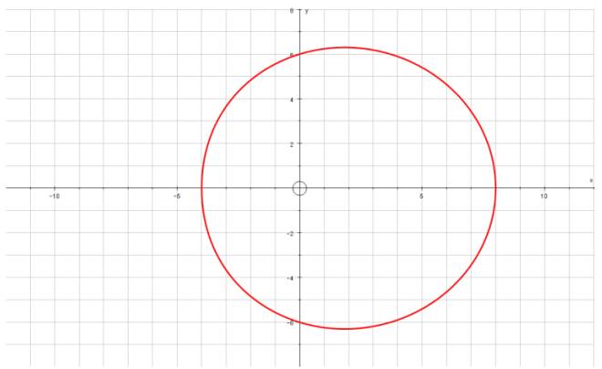
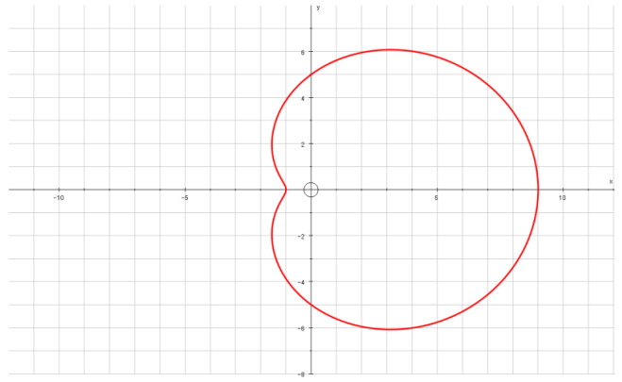
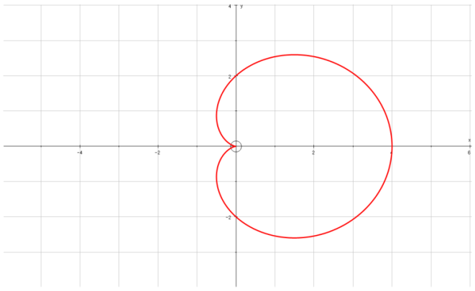
Polar Coordinates
$$\frac{dy}{dθ}=0$$
$$Parallel to the initial line$$
$$\frac{dx}{dθ}=0$$
$$Perpendicular to the initial line$$
$$x=rcosθ$$
$$y=rsinθ$$
You can use the Polar equation to find tangents to a curve that are parallel or perpendicular to the original line
Prove that for:
r = (p + qcosθ), p and q both > 0 and p ≥ q
to have a ‘dimple’, p < 2q and also
p ≥ q.
(so q ≤ p < 2q)
→ We can use the ideas we have just seen for finding tangents here…
If the graph is convex, there will be 2 tangents that are perpendicular to the initial line
If the graph has a ‘dimple’, there will be 4 solutions
If the graph is a cardioid, there will be 3 solutions (the curve does not go vertical at the origin here)
7E

Slide 86
Polar Coordinates
$$\frac{dy}{dθ}=0$$
$$Parallel to the initial line$$
$$\frac{dx}{dθ}=0$$
$$Perpendicular to the initial line$$
$$x=rcosθ$$
$$y=rsinθ$$
You can use the Polar equation to find tangents to a curve that are parallel or perpendicular to the original line
Prove that for:
r = (p + qcosθ), p and q both > 0 and p ≥ q
to have a ‘dimple’, p < 2q and also
p ≥ q.
→ We can find ^{dx}/_{dθ} for the above curve, and set it equal to 0 (as we did previously)
→ We can then consider the number of solutions, based on the sine or cos graphs – we need 4 for a ‘dimple’ to exist
$$x=rcosθ$$
Replace r using the equation
$$x=(p+qcosθ)cosθ$$
Multiply out the bracket
$$x=pcosθ+q\cos^{2}θ$$
Differentiate (using the Chain rule where needed)
$$\frac{dx}{dθ}=$$
$$−psinθ$$
$$−2qcosθsinθ$$
Chain rule for qcos²θ
$${qcos}^{2}θ$$
We are looking for places where the curve is perpendicular to the initial line, so ^{dx}/_{dθ} = 0
$$−psinθ−2qcosθsinθ=0$$
$${q\left(cosθ\right)}^{2}$$
Factorise
$$sinθ(−p−2qcosθ)=0$$
$${2q(cosθ)}^{1}$$
$$\left(sinθ\right)$$
$$sinθ=0$$
$$−p−2qcosθ=0$$
$$θ=0 or π$$
$$2qcosθsinθ$$
Add -2qcosθ
$$−p=2qcosθ$$
We don’t need to include 2π as it is a repeat of the solution for 0
→ This gives us 2 solutions so far…
$$−\frac{p}{2q}=cosθ$$
Divide by 2q
Solving this equation can give us 0, 1 or 2 answers depending on p and q…
7E

Slide 87
Polar Coordinates
$$\frac{dy}{dθ}=0$$
$$Parallel to the initial line$$
$$\frac{dx}{dθ}=0$$
$$Perpendicular to the initial line$$
$$x=rcosθ$$
$$y=rsinθ$$
$$sinθ(−p−2qcosθ)=0$$
You can use the Polar equation to find tangents to a curve that are parallel or perpendicular to the original line
Prove that for:
r = (p + qcosθ), p and q both > 0 and p ≥ q
to have a ‘dimple’, p < 2q and also
p ≥ q.
As the value for cosθ is negative, it must be between ^{π}/₂ and ^{3π}/₂
$$sinθ=0$$
$$−\frac{p}{2q}=cosθ$$
$$θ=0 or π$$
If p > 2q
Eg) p = 5, q = 1
The fraction will be top-heavy
(in this case -⁵/₂)
Cosθ will be less than -1
No solutions in this range
If p < 2q
Eg) p = 3, q = 2
The fraction will be ‘regular’
(in this case -³/₄)
Cosθ will be between 0 and -1
2 solutions in this range
1
Cosθ
0
If p = 2q
Eg) p = 6, q = 3
Cos θ = -1
1 solution (θ = π)
So p ≥ q
-1
^{π}/₂
π
^{3π}/₂
2π
and
p < 2q
Therefore:
q ≤ p <2q
7E

Slide 88
Polar Coordinates
$$\frac{dy}{dθ}=0$$
$$Parallel to the initial line$$
$$\frac{dx}{dθ}=0$$
$$Perpendicular to the initial line$$
$$x=rcosθ$$
$$y=rsinθ$$
You can use the Polar equation to find tangents to a curve that are parallel or perpendicular to the original line
Prove that for:
r = (p + qcosθ), p and q both > 0 and p ≥ q
to have a ‘dimple’, p < 2q and also
p ≥ q.
Yes, you were actually just given this part of the solution!
→ If p was not greater than q, there would be a lot of undefined areas on the graph, and hence the full shape would not exist (there may actually be no defined areas at all)
7E

Slide 89
Summary
We have learnt how to plot Polar equations
You now know how to convert equations between Polar and Cartesian form
You have also seen sketching curves
You have used Integration and differentiation with Polar coordinates!

